Slide 1
Renewable Energy
Hetényi Lőrinc Attila

Slide 2
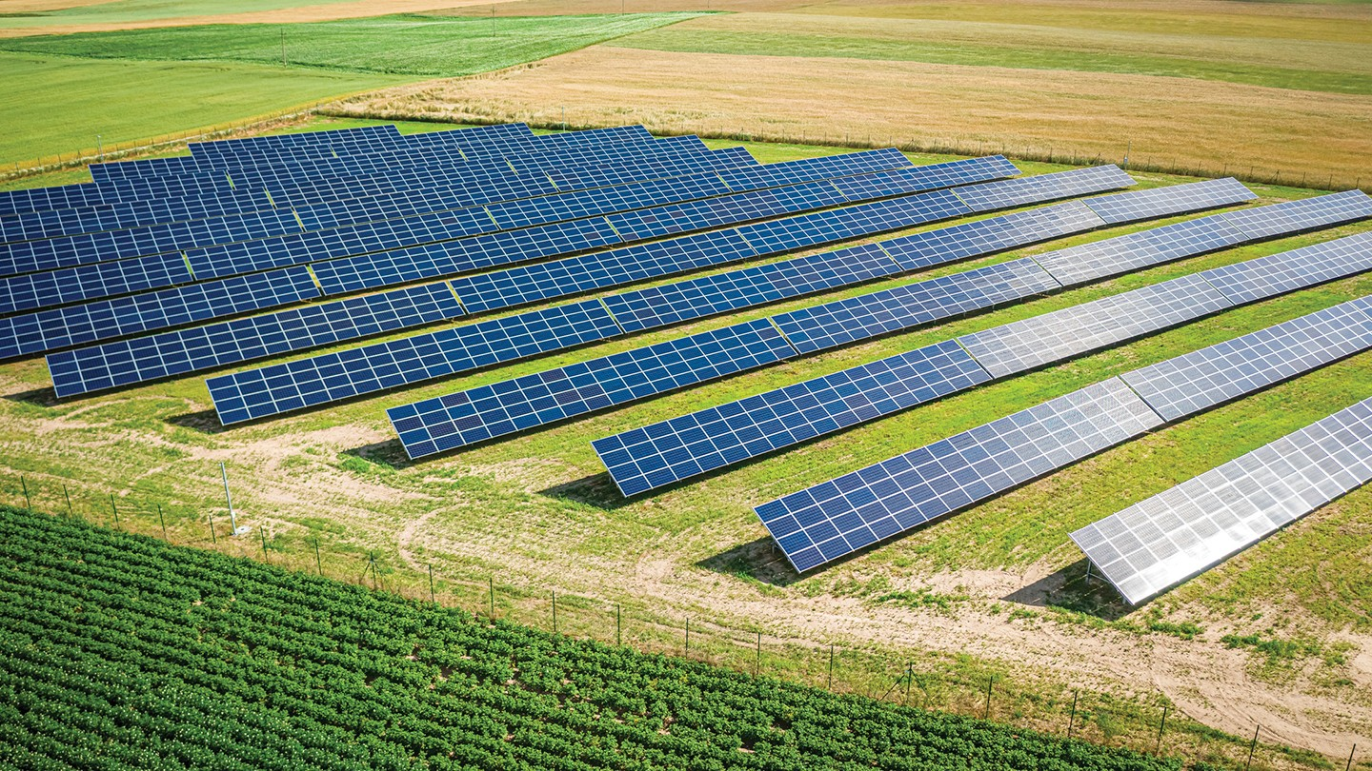
What is renewable energy?
Energy source won’t run out
Usually has a low carbon footprint
Examples include:
Wind
Solar
Hydroelectric
Bioenergy (organic matter burnt for energy)

Slide 3
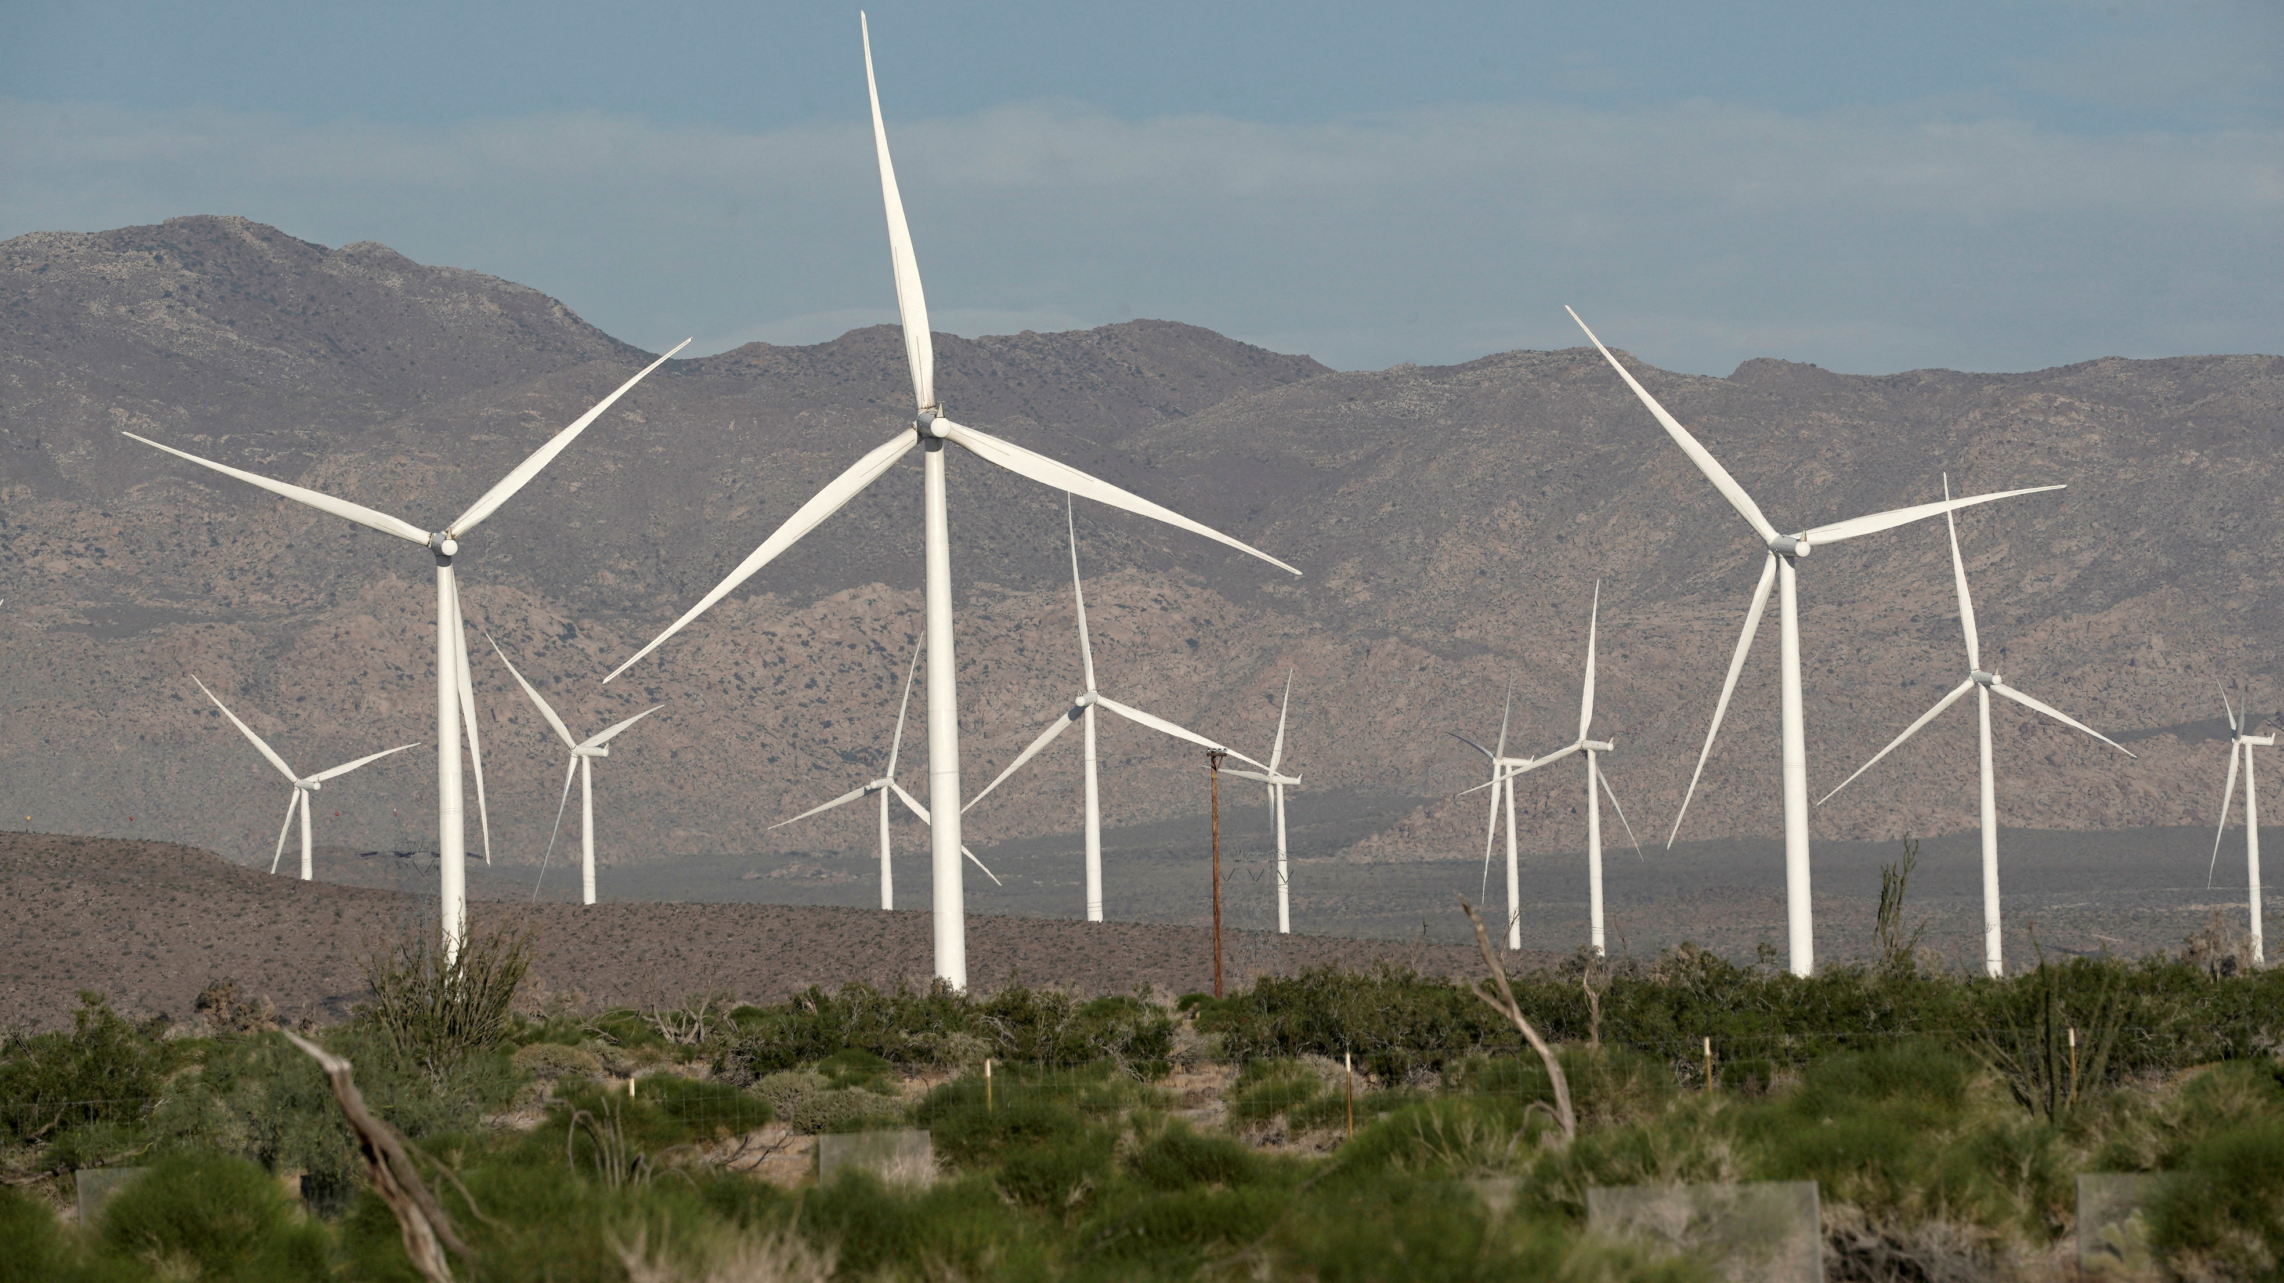
“Clean” energy
Low carbon emissions or low general pollution
Doesn’t need to be renewable
Nuclear energy is widely considered clean

Slide 4
Pros and cons of renewables
Pros:
Low pollution and carbon footprint
Doesn’t deplete land resources (with little exceptions)
Source won’t run out
Cons:
More expensive than fossil fuels/natural gas
Unpredictable power shortages due to weather

Slide 5
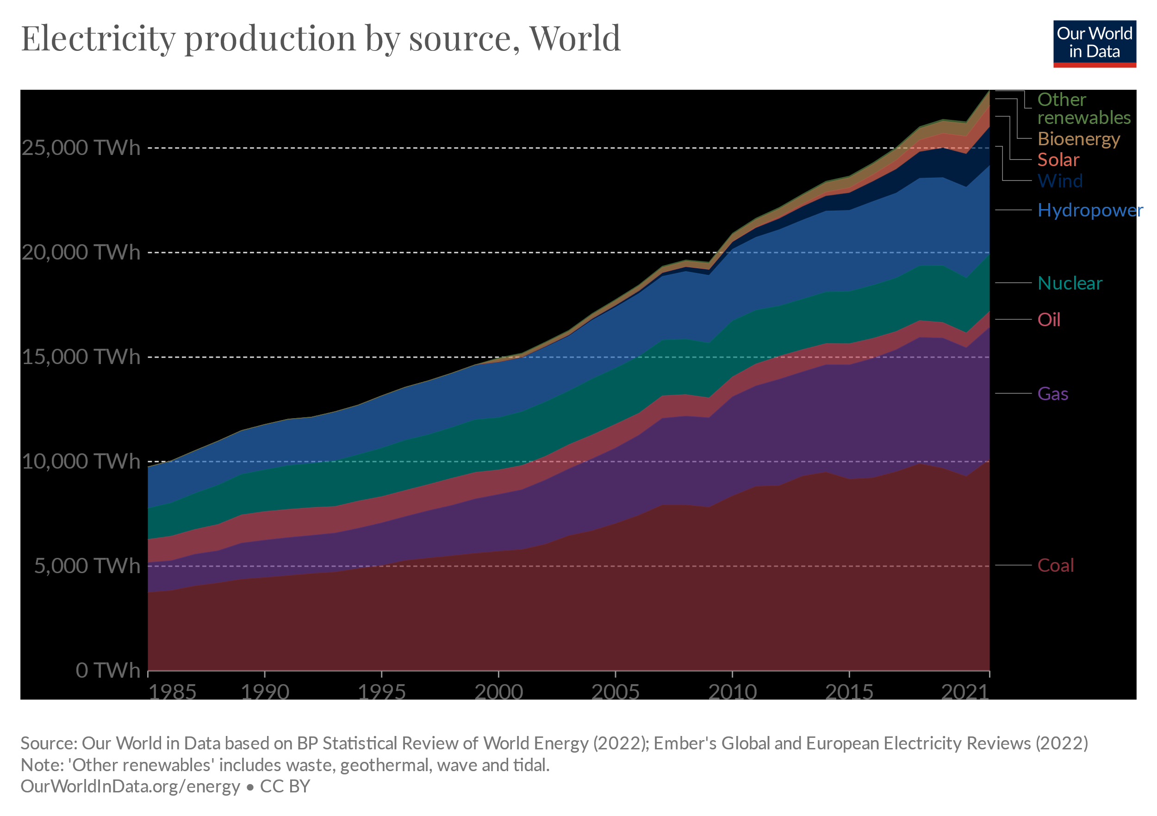
Global power sources
According to British Petrol the most common power sources during 2021 were the following:
Coal
Gas
Hydroelectric
Nuclear
Wind
Oil
Solar
Bioenergy
Other

Slide 6
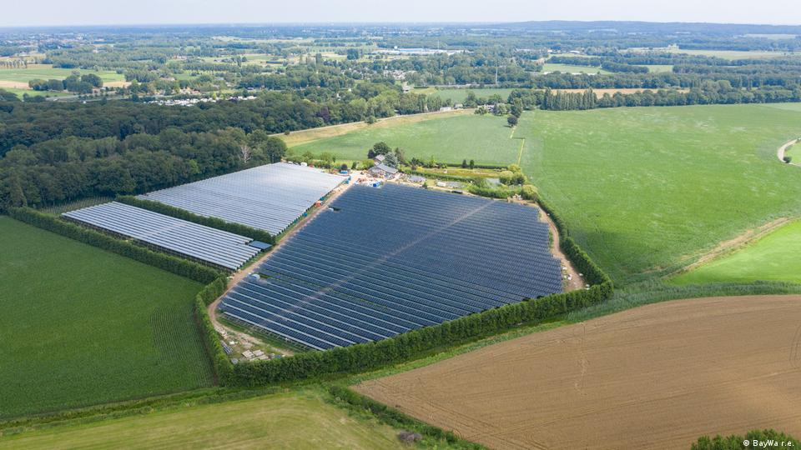
Solar energy
Solar panels
Can be generated locally (on rooftops)
Dependent on location
Makes 9kWh/m² on average
Mirror array complex (CSP)
Requires empty field
Dependent on location
Generally higher energy output than solar panels

Slide 7
Mirror array complex (CSP)
Tower system:
Mirrors concentrate solar power onto a water tower
The water turned to steam runs through a turbine
The water gets forced back to the tower
Pipe system:
Linear:
Mirrors placed flat on the ground with a pipe above them
Pipe contains water or thermal oil that gets heated up
Heated up liquid turned gas runs through a turbine and repeats
Parabolic:
Curved trough-shaped mirrors direct sunlight onto a pipe
Rest of the process identical to linear

Slide 8
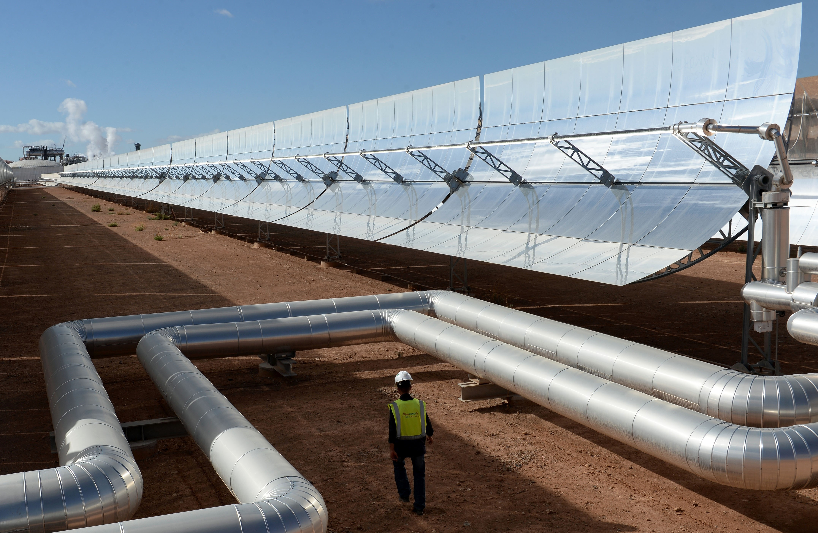
Tower system
Pipe System (Parabolic)

Slide 9
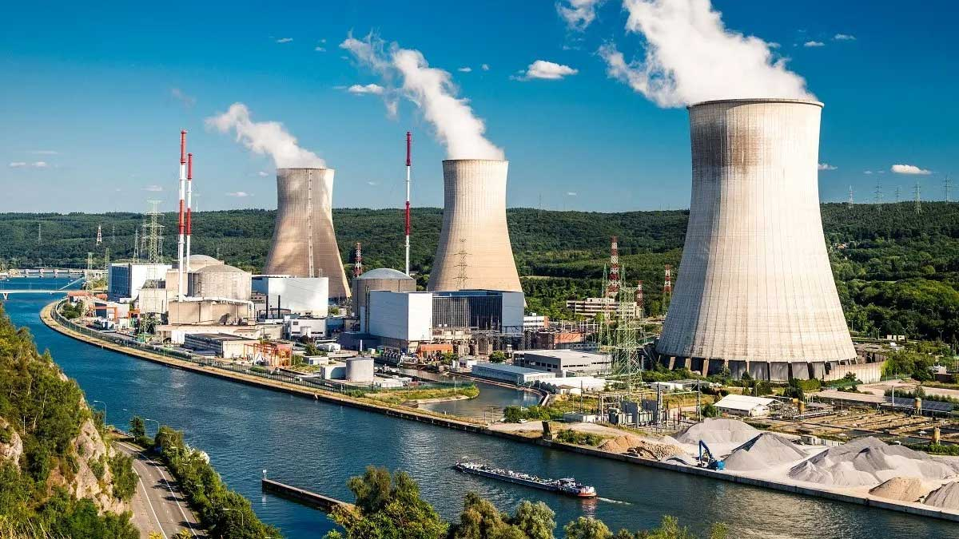
Clean, but not renewable
The cleanness nuclear energy is a somewhat debated topic
If all safety precautions are followed, nuclear energy is clean
Some disasters may happen from time to time
Disasters are getting more uncommon due to better equipment and safety measures
They work by heating water with the heat of nuclear fission, and the steam gained from it is driven through a turbine

Slide 10
Nuclear disasters “dampen”
The most widely known nuclear disaster is the Chernobyl nuclear disaster (1986) that cost est. 68 Billion USD
At the time there were 386 active nuclear power plants worldwide
Today there are nearly 450 active nuclear reactors worldwide and no damage of such magnitude since 1986 (since 37 years), which is more time than the time between the first nuclear reactor (1954) and Chernobyl, which is 32 years
A more recent disaster, Fukushima nuclear disaster (2011), had an est. damage cost of 480-660 million USD. It doesn’t come close to Chernobyl’s est. 68 Billion. This is due to more modern safety precautions and timely evacuations.

Slide 11
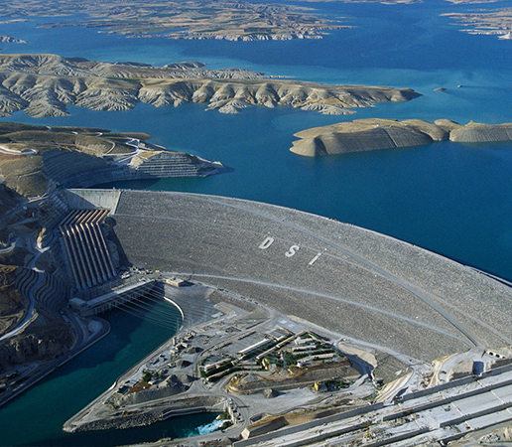
Hydroelectric
Hydroelectric is the least unpredictable renewable energy source, but
Hydroelectric is the one renewable most prone to causing environmental damage
Dams should be constructed regarding their effects
Huge dams can withdraw a large amount of water from a river. The effects can be detrimental to those living downstream, or those near the reservoir.
Dams can cause droughts downstream
They can also cause flooding if they let water through very fast after prolonged withdrawal of water

Slide 12
Importance of geography
Unlike most energy plants, renewables shouldn’t be built anywhere.
The geographical location of the equipment is of high strategical importance
Solar panels work better closer to the equator
Wind turbines work better in windy, open regions such as plains, or coastal regions

