Slide 1
Saving energy
Made by: Dorka Rácz

Slide 2
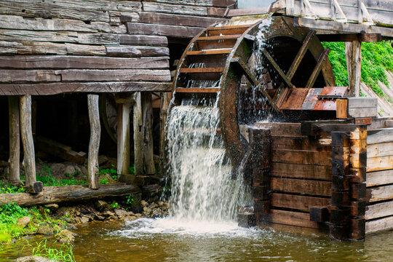
How people use Energy
People use energy for various devices and mechanisms to operate.
Approximately 2000 years ago the Greeks and Romans edged grains and olives in watermill
Now people use energy for almost everything

Slide 3
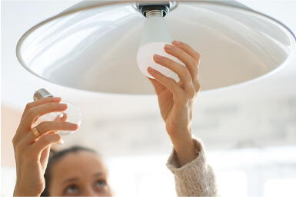
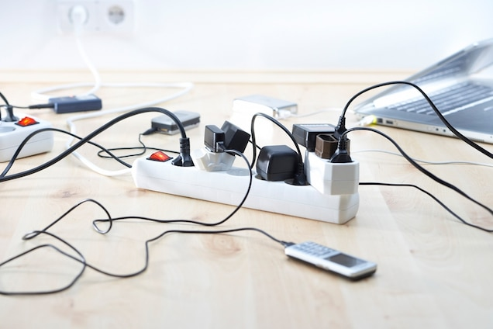
People use energy at home:
60% for heating
25% water for washing, laundering
15% for lighting and electricity

Slide 4
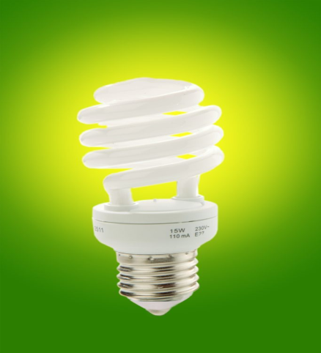
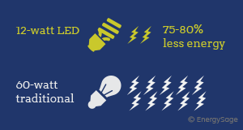
How we save electrical energy
Lighting- light bulbs, lamps, chandeliers outdoor lamps.
We can save energy by buying new economical light bulbs like this
Those bulbs have ten times longer live and with theese bulbs we can save energy and money too.

Slide 5
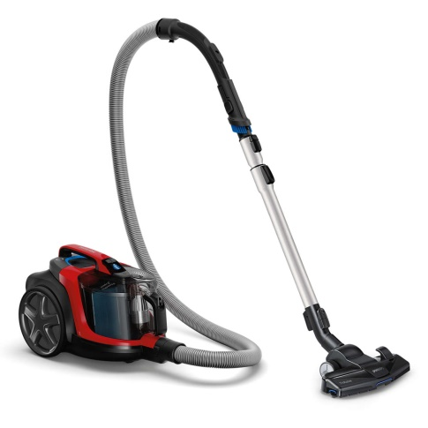
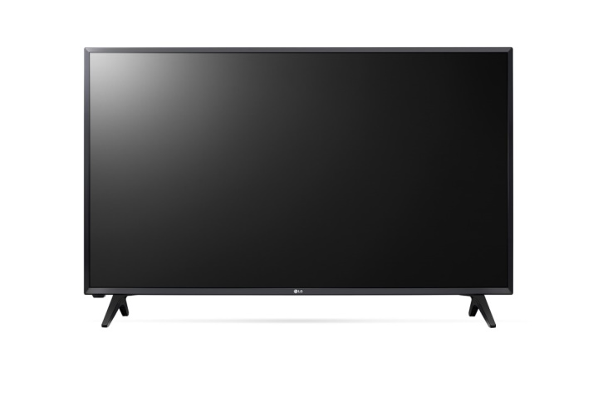
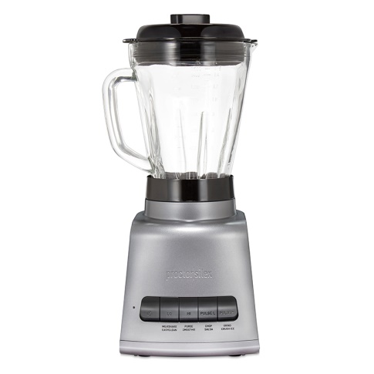
Other electric appliances
Electric appliances – a TV, computers, ovens, blenders, irons, vacuumcleaners, printers, and other devices

Slide 6
How can we save the energy at home:
We save energy by turning off the computers, TV, Xboxes, play stations and other devices when we do not use them

Slide 7
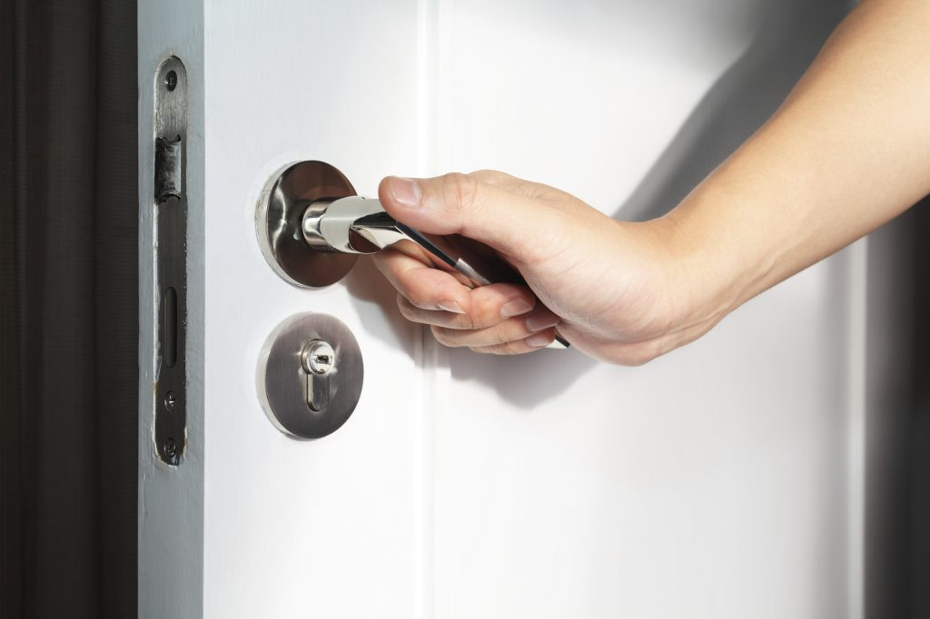
A small make over in our home:
Replacement of windows and doors to close
Install solar collector
Use more earth energy
Use economical electric boiler
Replace household appliances AAA category

Slide 8
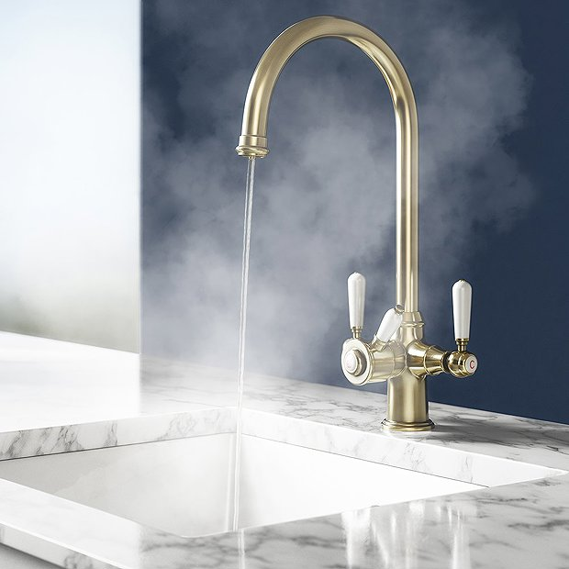
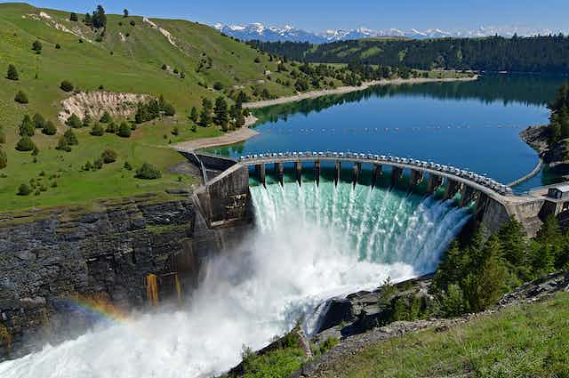
Save water energy
If you save water, you will save energy too. When we wash hands, brush teeth we save water, water tap is not all the time open. When we finish we just turn off the water tap.

Slide 9
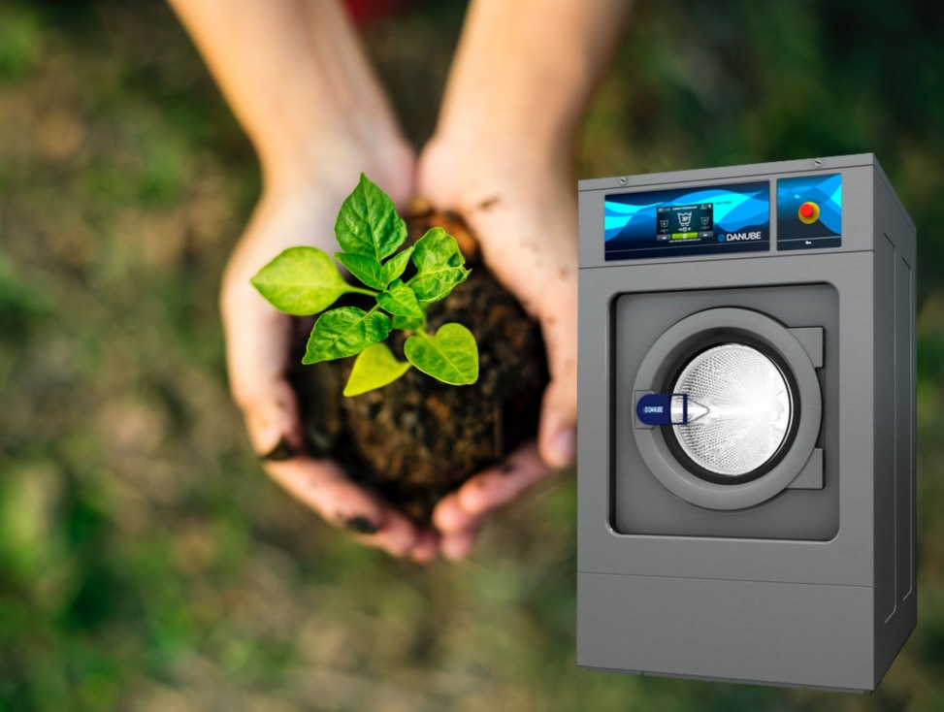
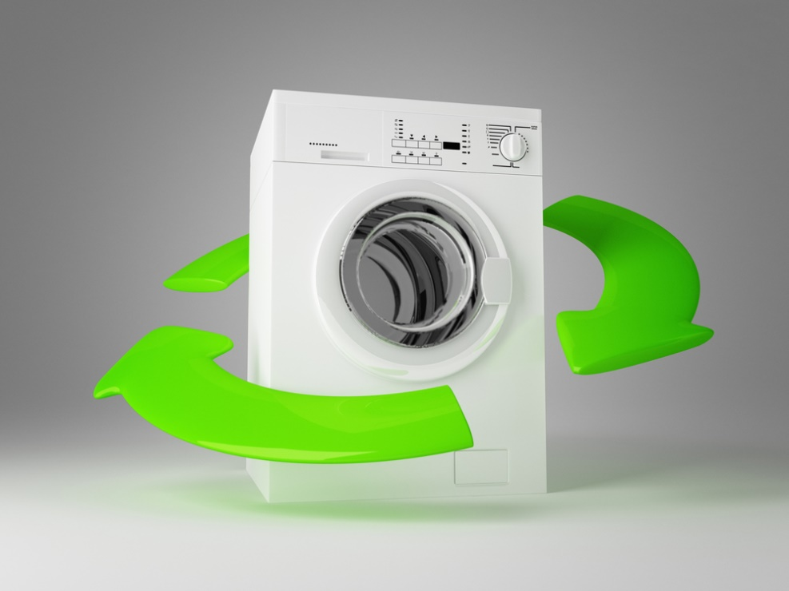
Save water with household appliances
Use water saving wahing machine and dishwasher!

Slide 10
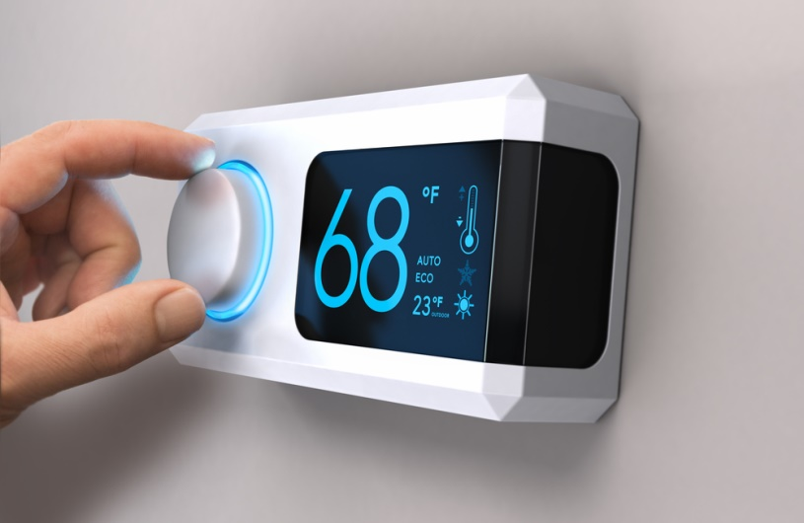
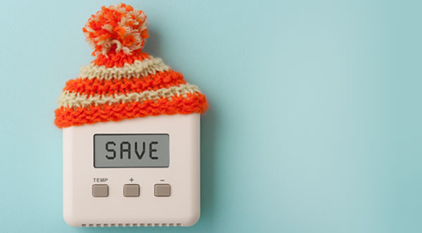
Save heating energy
We have heaters fitted with a thermostat or hand-operated valve for regulating the flow because when we are not at home we turn off the heaters.
Our home has an external wall insulation. It is highly efficient and significantly reduces heat loss.

Slide 11
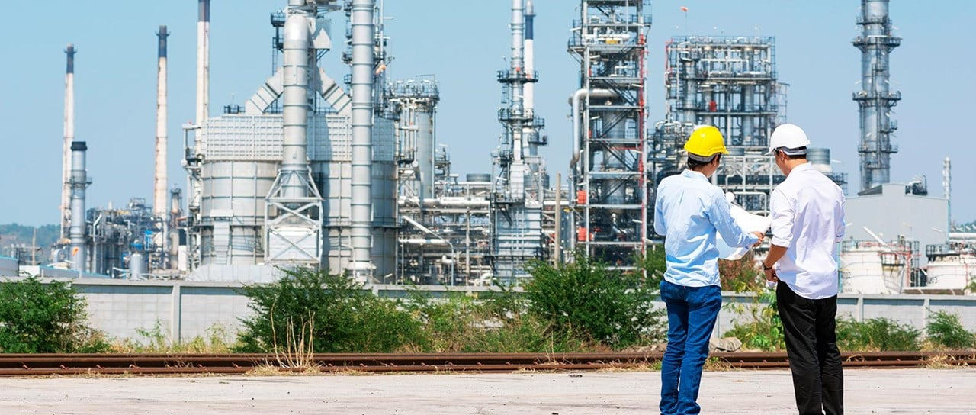
Energy in large-scale industry
The big factories should then strive to use reneval energy like wind energy, solar sistem and water energy.

Slide 12
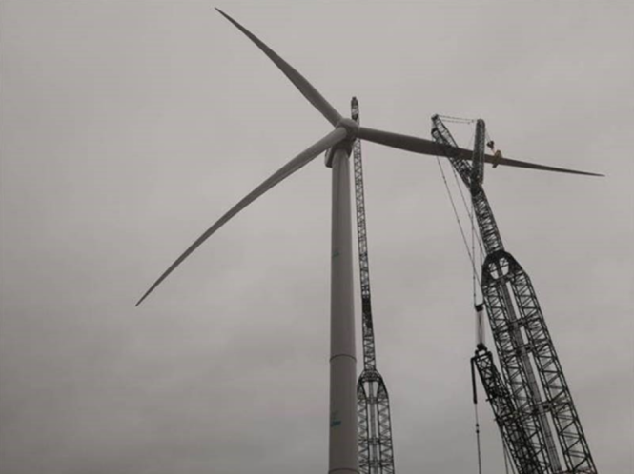
Some interesting information about energy
Approximately one fifth of all the energy is hydroelectric power
Record: the world’s largest wind turbine wing is more than 50 m long
Worldwide, about 17% of the electricity is consumed for lighting

Slide 13
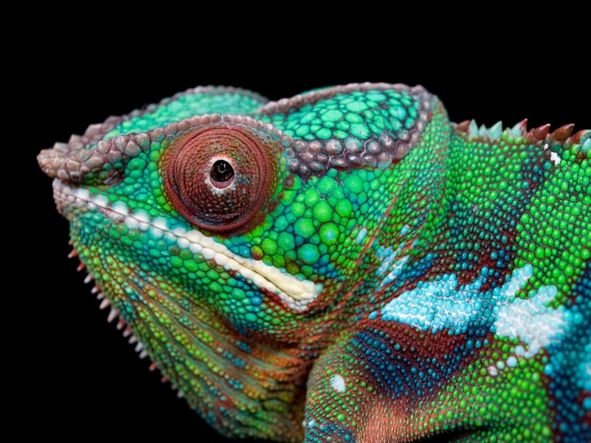
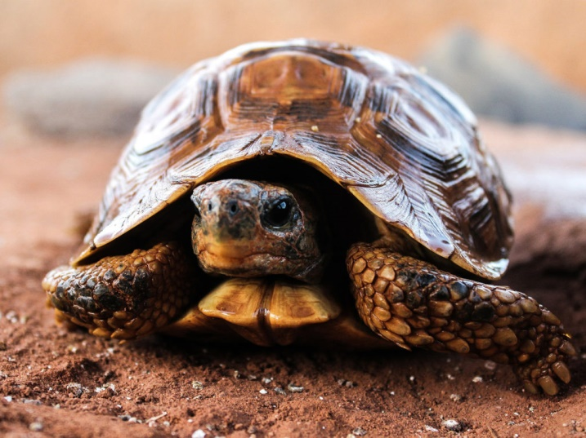
Intresting in our home
Our family’s hobbie is keeping reptiles. We have tourtles and lizards. They need warm, light and UW light. We have to use a lot of special lamps and bulbs with it. In winter time we reduce the lighting time 10 hours a day. Summer time we keep them in the garden. Use the sun energy for them.

Slide 14
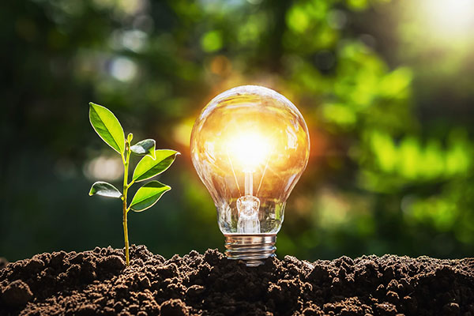
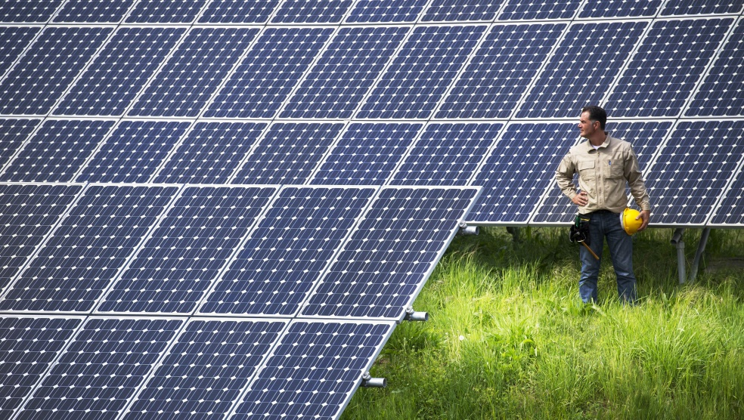
Responsibility
It’s everyone’s responsibility to save energy that the wounderful planet earth is not destroyed and be liveable.

Slide 15
Thanks for watching!

