Slide 1
Recycle

Slide 2
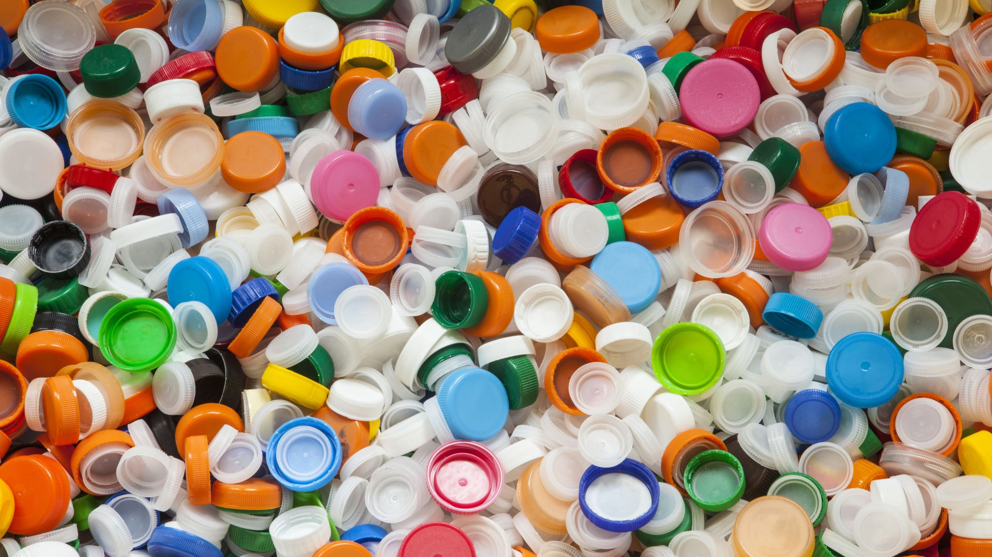
What is recycling?
Recycling can be:
The process of converting waste materials into new materials
Also process of making new objects
Might be also making arts of waste materials
Is saving our planet
Is caring of next generations

Slide 3
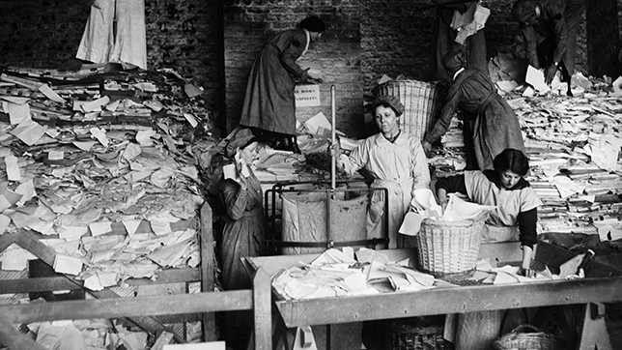
The history of recycle
Many people think that recycling started just few years ago, but this isn’t true
For example in the early 1820s in London, waste was collected almost 100%
And in 1889, the first waste sorting plant for recycling was opened in New York
Unfortunately in Hungry recycling is not so known and popular thing(yet), just for exaple in some other countries like Austria, Germany or Finland the recycling percent of recycling waste is about 70 percent, in Hungry that number is 20 , luckily that number is growing all the time

Slide 4
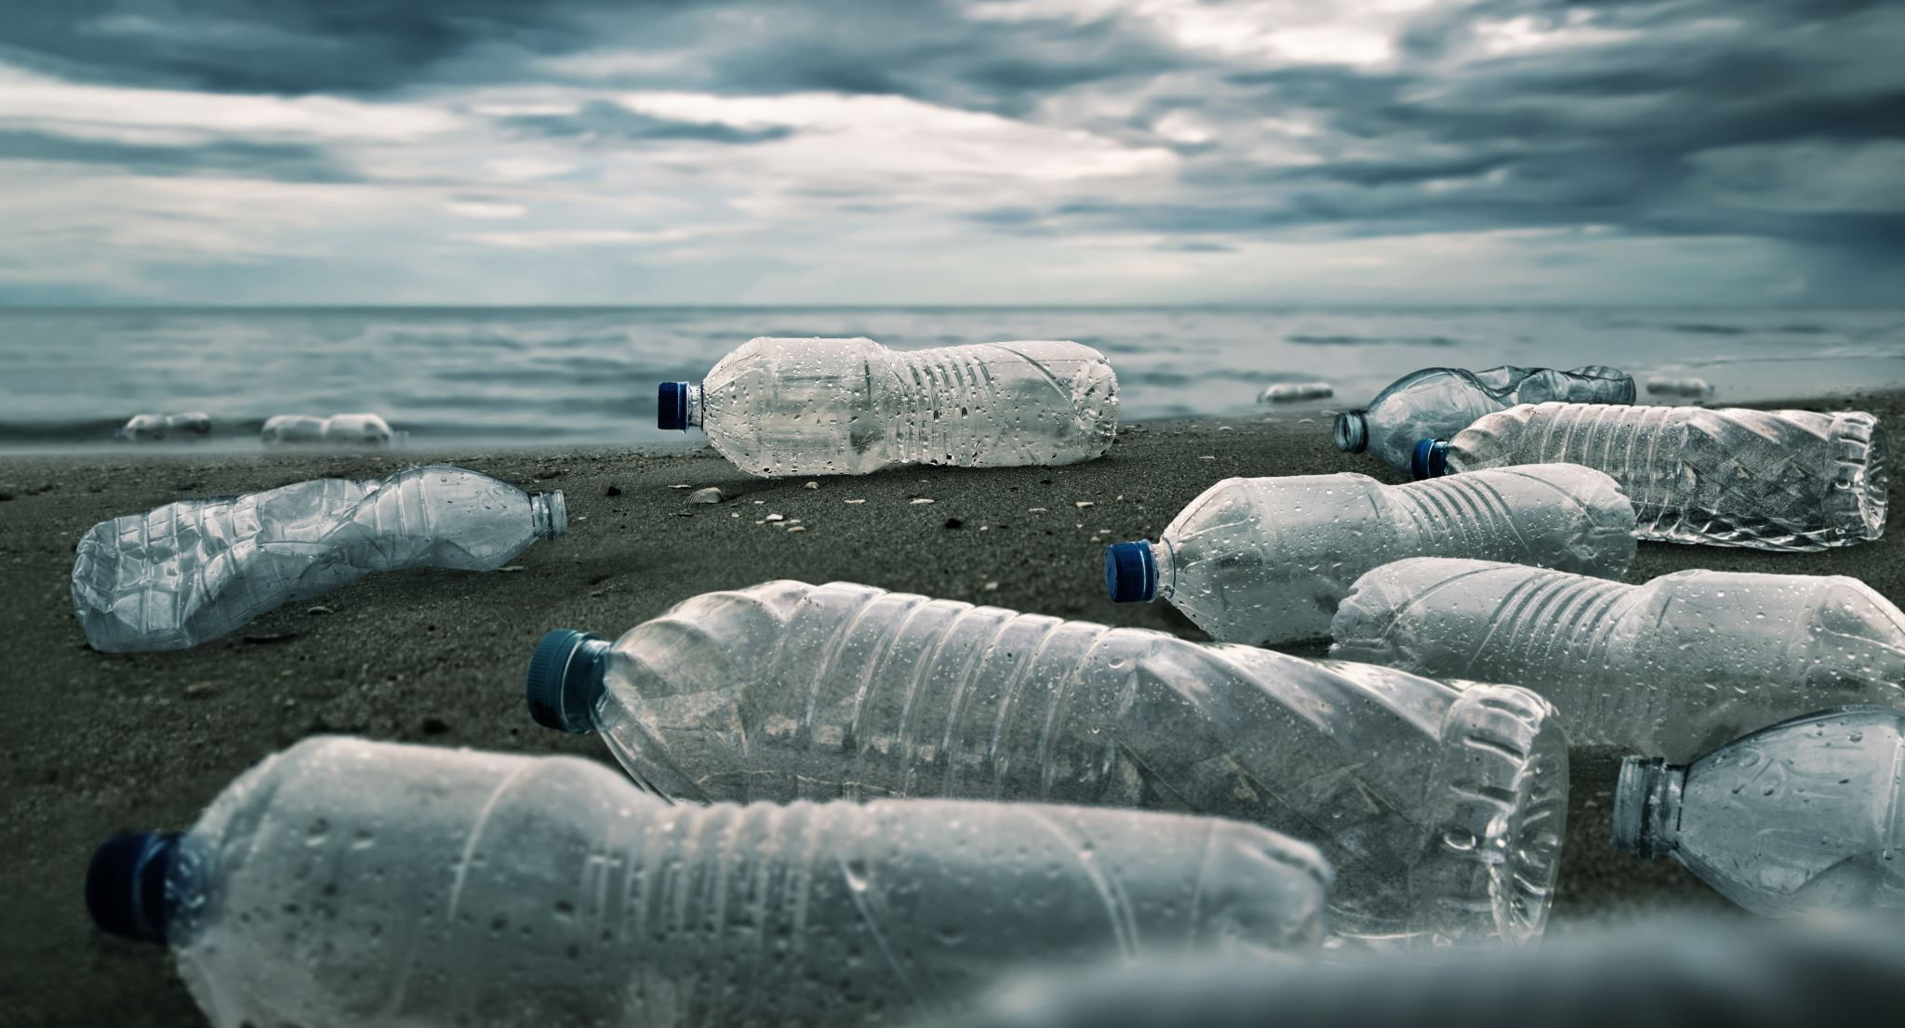
The importance of recycling
Every day people are “making” tons of waste in every household and also in business starting from the smallest boutique to the big malls
Factories are very large and problematic source of waste
Without recycling the processing of waste is very expensive and polluting and it would be almost impossible to make it work

Slide 5
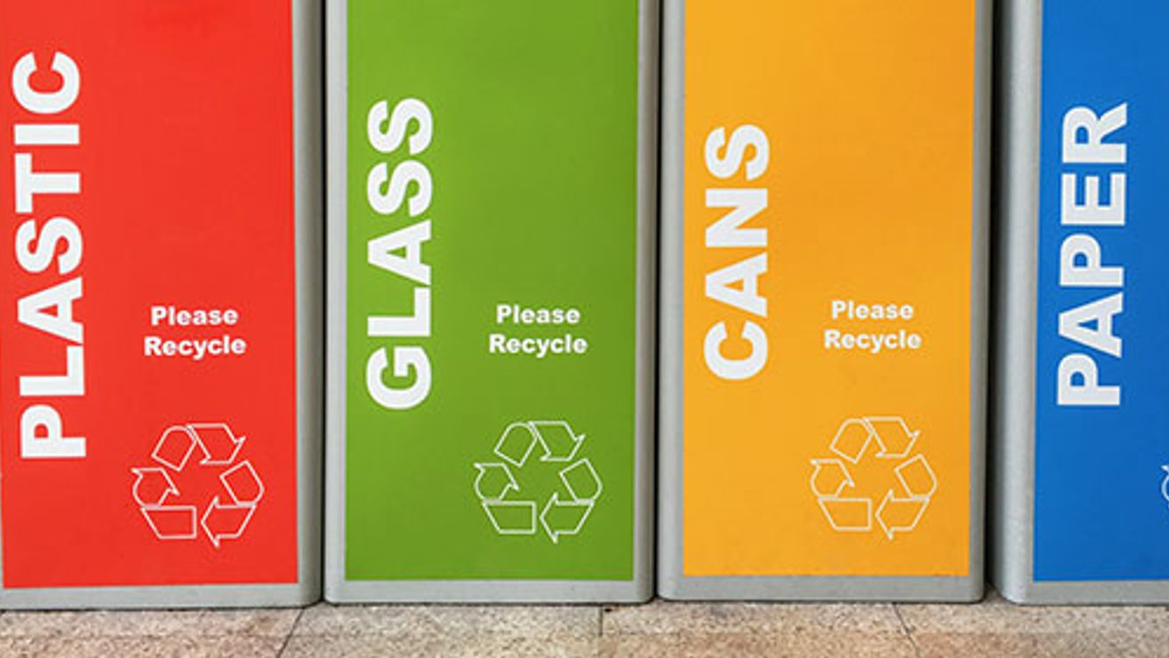
How to recycle things?
The big difference is whether the recycled material comes from household or industry
All materials have their own process for recycling
It’s important to know excatly how to celect tha waste

Slide 6
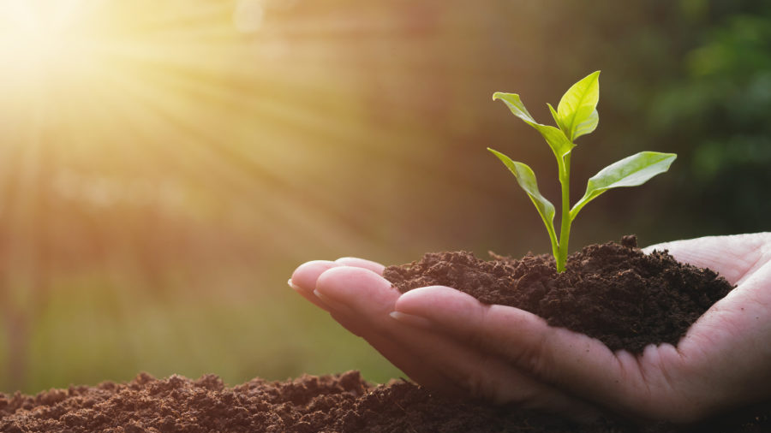
What is it good for?
Conservation
Pollution reduction
Making new things
Employment

Slide 7
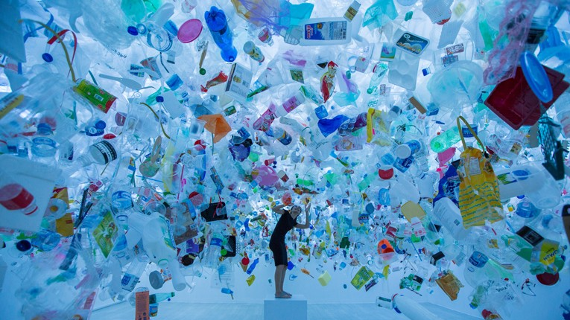
What can we recycle?
Plastic
Paper
Glass
Textils
Metals
Food

Slide 8
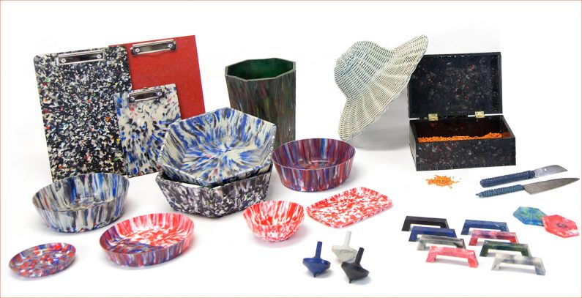
What can we do from the things we recycle?
Nowadays the way of recycling and making new things of recycled materials almost has no limits.
For example:
New paper
Clothes
Bags
Furnitures
Building materials

Slide 9
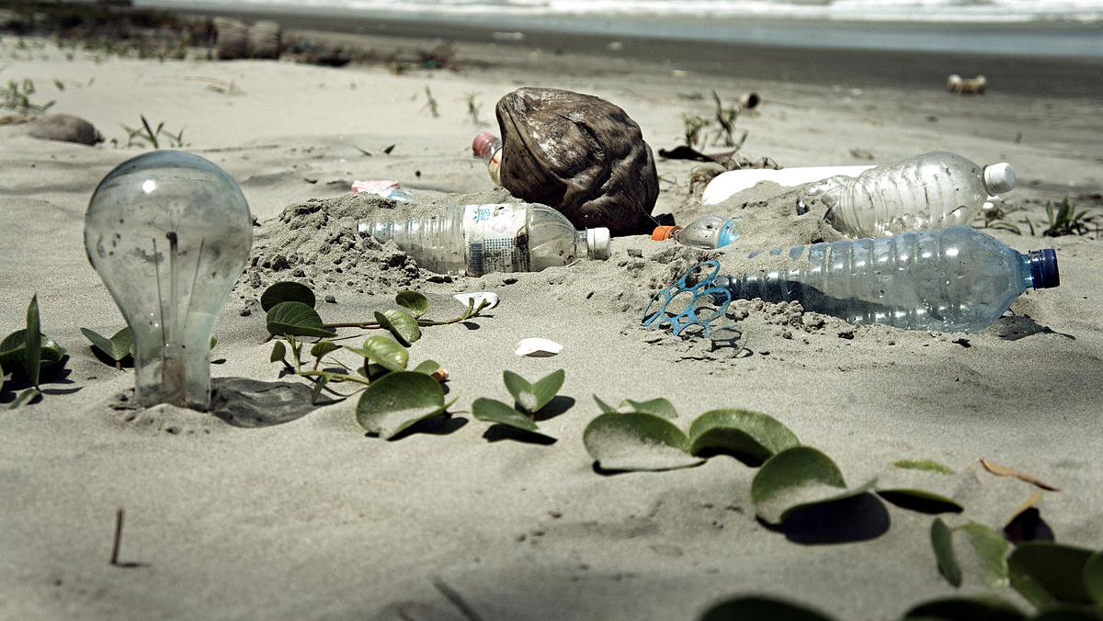
What happens to the things we don’t recycle?
The waste that we don’t recycle often go to the nature and we can find it every where even in our clear drinking water

Slide 10
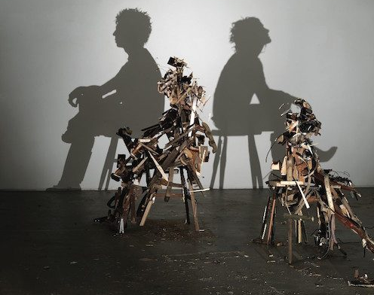
Recycling in art

