Slide 1
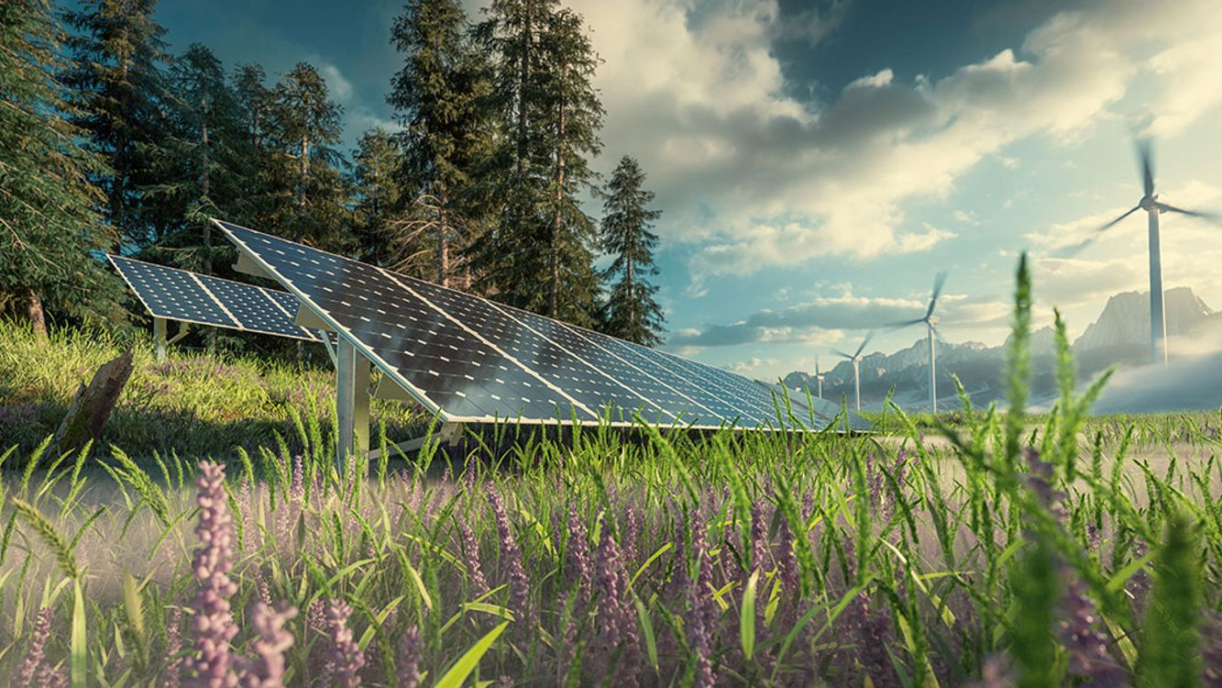
Renewable energy
by lena hamar

Slide 2
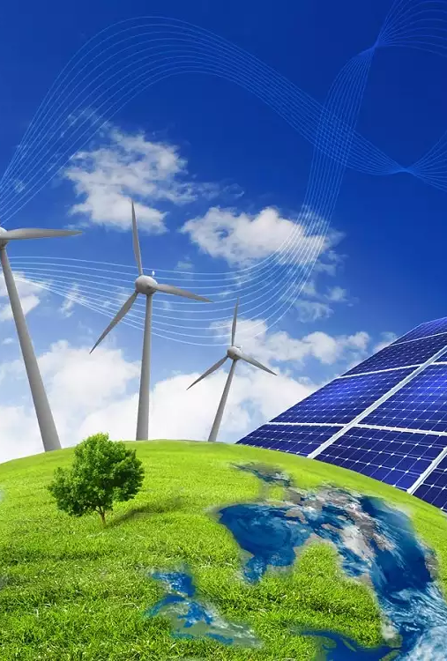
What is renewable energy?
Renewable energy is energy that is derived from natural sources.
These are such sources that are constantly being replenished.
Plentiful and also all around us.
Renewable energy:
Wind energy
Solar energy
Geothermal energy
Hydropower
Ocean energy
Bioenergy (biomass)
Wave energy

Slide 3
Wind energy
We use large wind turbines onshore or offshore. This machine produces the kitenic energy of moving air.
The best location for generating wind power are somethimes remote ones.
Offhore wind energy offers enormous potential.

Slide 4
Solar energy
Solar energy can deliver electricity for lighting, heating and cooling.
These technologies convert sunlight into electrical energy.
Solar energy can even be harnessed in cloudy weather.
Direct solar energy is available for every country.
It is affordable and often the cheapest solution of electricity.

Slide 5
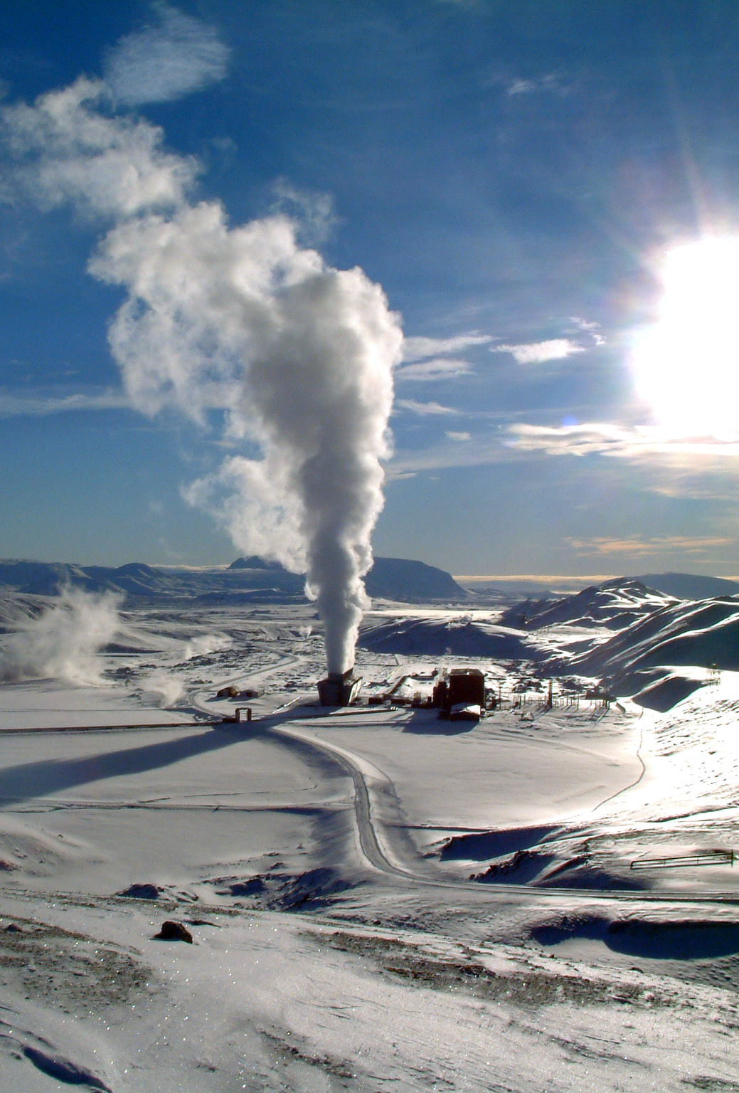
Geothermal energy
Geothermal energy is the heat produced deep in the Earth’s interior.
It is a clean, renewable resource, that can be harnessed for use as heat and transform to electricity.
People started to use geothermal energy thousands of years ago. (In ancient Rome, people built spas and baths around the natural hot springs. Maori women cooked basket-held food in the boiling thermal water.)

Slide 6
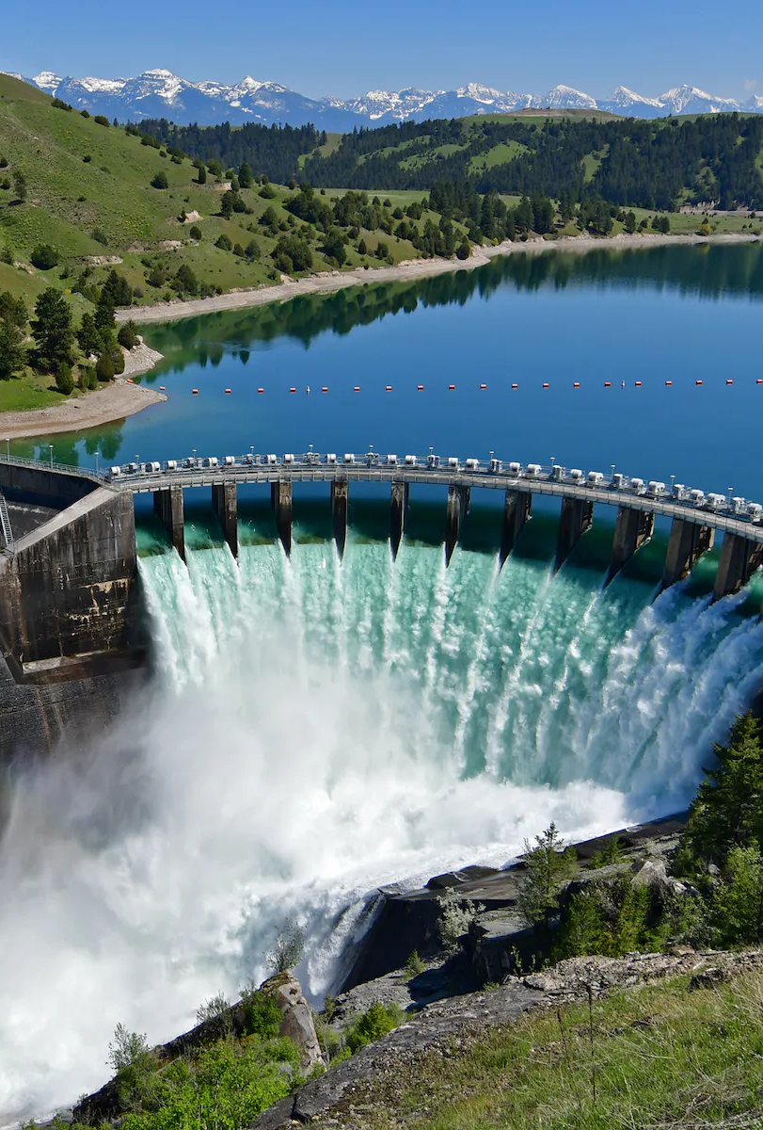
Hydropower
Hydropower (known as hydroelectric power) generates power by using the kinetic power of downstreaming water.
This source of energy relies on the endless, constantly recharging system of water cycle in order to produce electricity.
Hydropower is currently the largest source of renewable energy.

Slide 7
Ocean energy
Ocean energy is a limitless, indigenous source of power, right on our doorstep.
Ocean energy originates from technologies that use the kinetic and thermal energy of seawater.
These technologies exploit the power of tides and waves, as well as differences in sea temperatures and salinity, to produce electricity or heat..

Slide 8
Bioenergy
Bioenergy is a low-carbon renewable enrgy that is produced by living organisms.
Energy created by burning biomass creates greenhouse gas emissions, but at lower levels than burning fossil fuels like coal, oil or gas.
It can be used to produce fuels, heat, electricity, and products.

Slide 9
Wave energy
Wave energy is relatively new form of renewable energy, that is harnessed by the motion of the waves.
The waves create kinetic energy, as they roll through the ocean.
Wave energy creates energy, that can be converted into electricity and power.
As long as the Earth continues to track around the sun, and the moon around the Earth, waves will continue to be a viable source of kinetic energy.

Slide 10
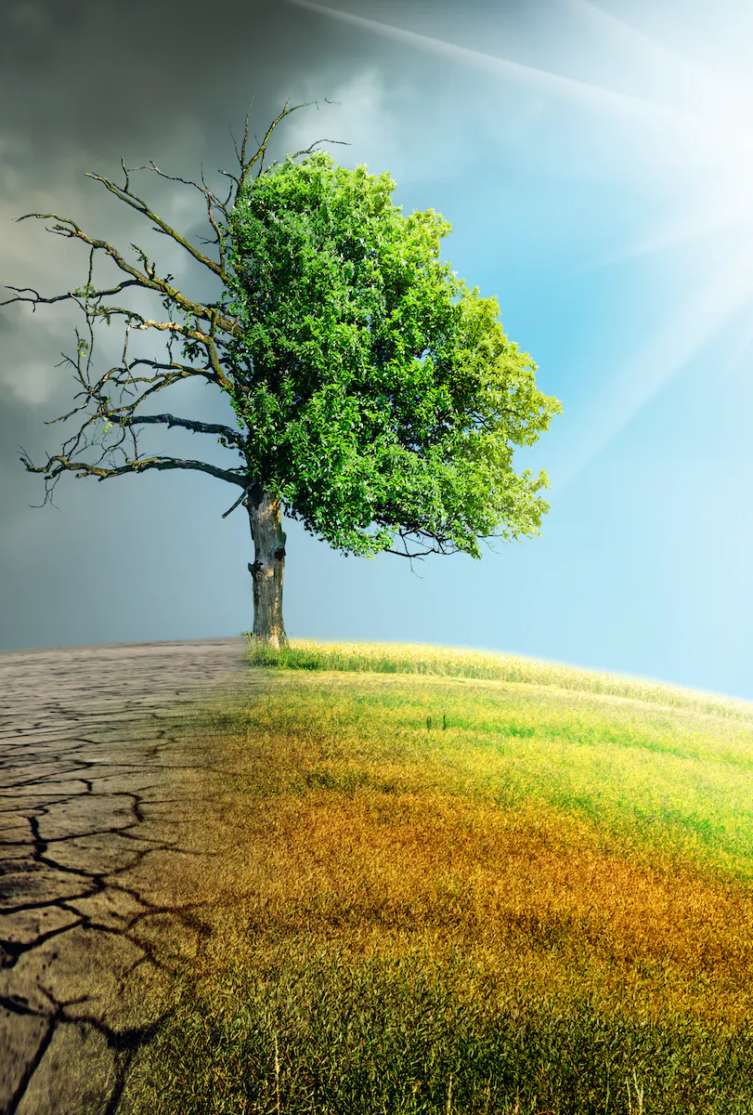
Why is renewable energy important to us?
Renewable energy minimizes carbon pollution and has a much lower impact on our environment, slowing down the climate change.
It cleans the air and reduces pollution.

Slide 11
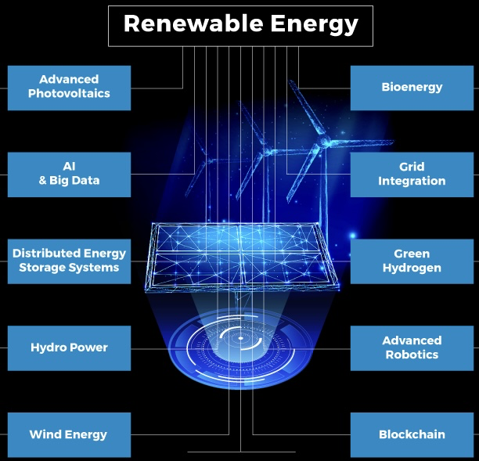
Top 10 renewable energy trends & innovations in 2023

Slide 12
KEYWORD: get more efficiant
Innovations in advanced photovoltaics (PV) focus on technologies that provide higher energy efficiency.
In addition, the use of big data and AI empowers renewable energy while also enabling other applications such as predictive maintenance and smart management.
Bioenergy continues to remain a popular trend due to its decentralized nature. To secure and automate renewables, energy startups and scaleups extensively leverage blockchain and robotics, among other technologies

Slide 13
KEYWORD: get more efficiant II.
Grid integration technologies also stabilize the grid by controlling transmission losses. As a result, it leads to efficient utilization of off-grid energy sources such as biofuels, wind, and hydro power located far away from demand centers.
Indirectly, green hydrogen stores energy obtained from other renewable sources and also facilitates electrification.
Distributed energy storage systems (DESS) provide flexibility and stabilization to renewable energy generation.

Slide 14
INTERESTING facts
Solar energy is almost 200 years old.
Iceland leads the world with near 100% energy produced from renewable sources.
Solar power could be the world’s top power source by 2050.
Costa Rica gets 99% if its energy from renewable sources.
About 30% of the world’s electricity comes from renewable energy.

Slide 15
WEB SOURCES
UNITEDNATIONS.ORG
NATIONALGEOGRAPHIC.ORG
MINESTRO.COM
OCEAN-ENERGY.EU
ENERGY.EC.EUROPA.EU
ENERGY.GOV
JUSTENERGY.COM
SEAI.IE
STARTUS-INSIGHTS.COM

Slide 16
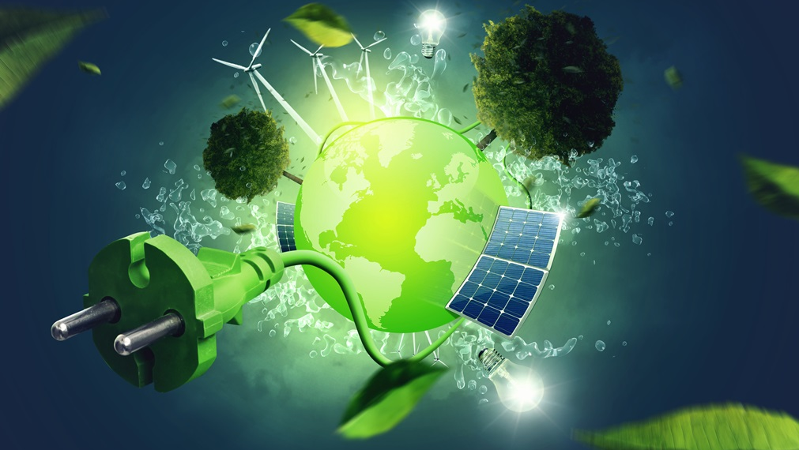
Thank you for the attention

