Slide 1
Vilnius Verkiai School - Multifunctional Center
Notes:
Skaidrė – slide
Next slide

Slide 2
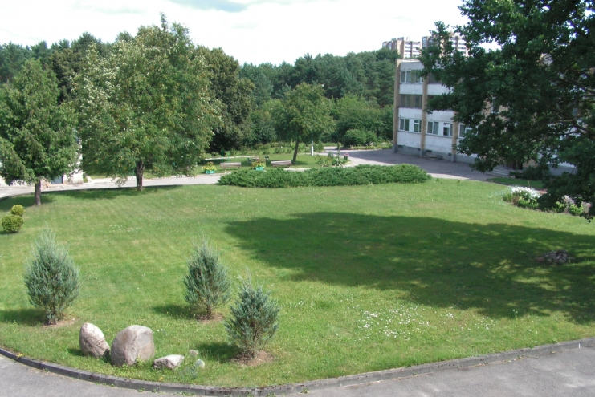
About the center
The center is located in a beautiful place in Vilnius between river Neris and Verkiu regional park.
We have a lot of green spaces.
Center for Special Educational Needs
The center provides quality education and social care for people with intellectual disabilities or developmental disorders in a safe, physically and mentally sustainable environment.

Slide 3
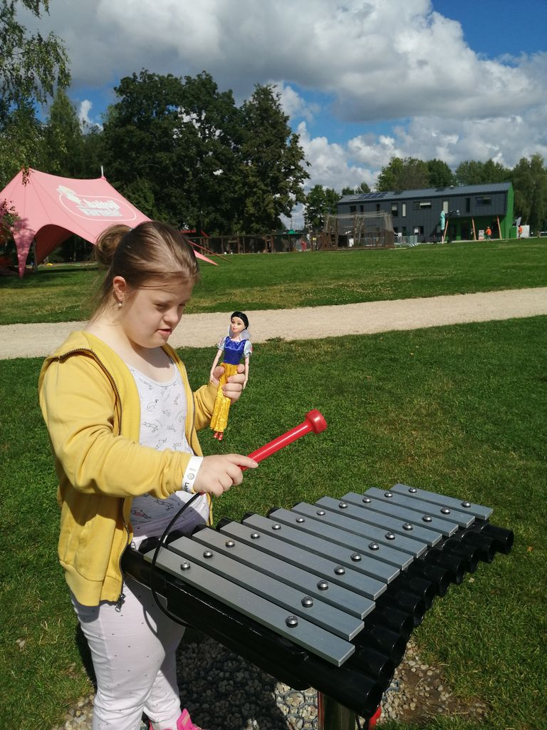
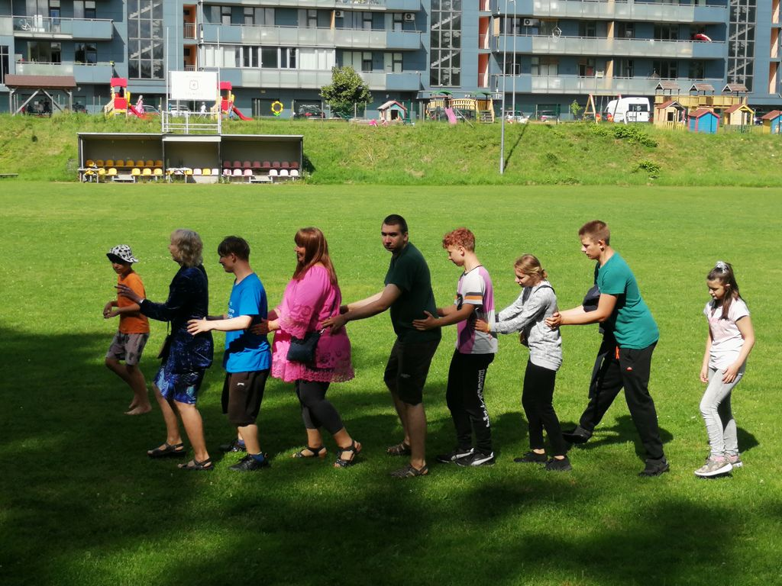
VISION & MISSION
Vision
The school community has a great learning environment provided by trustworthy and professional workers that seek to ensure the success of every child.
Mission
To help every pupil with special educational needs to achieve personal progress and new experiences by providing a quality education.

Slide 4
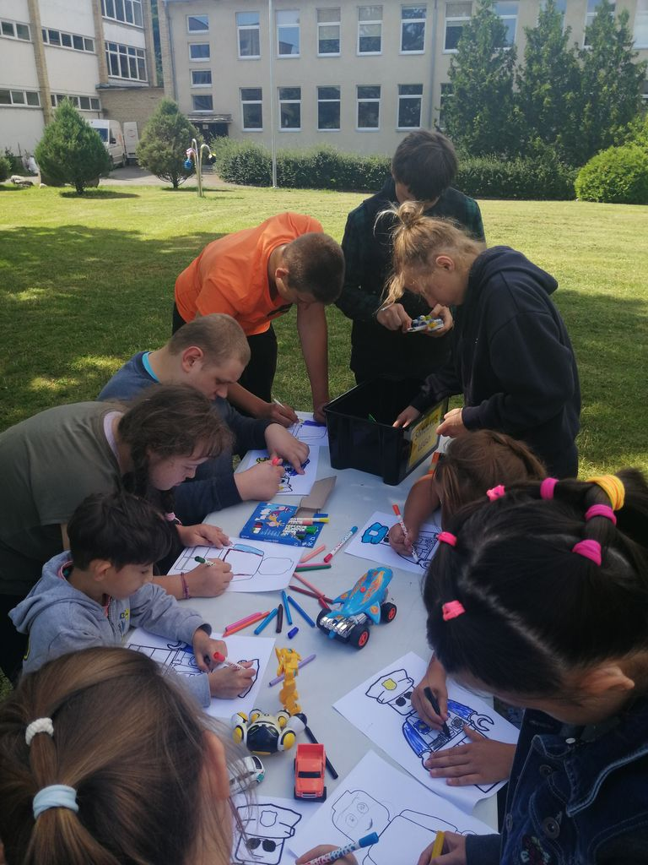
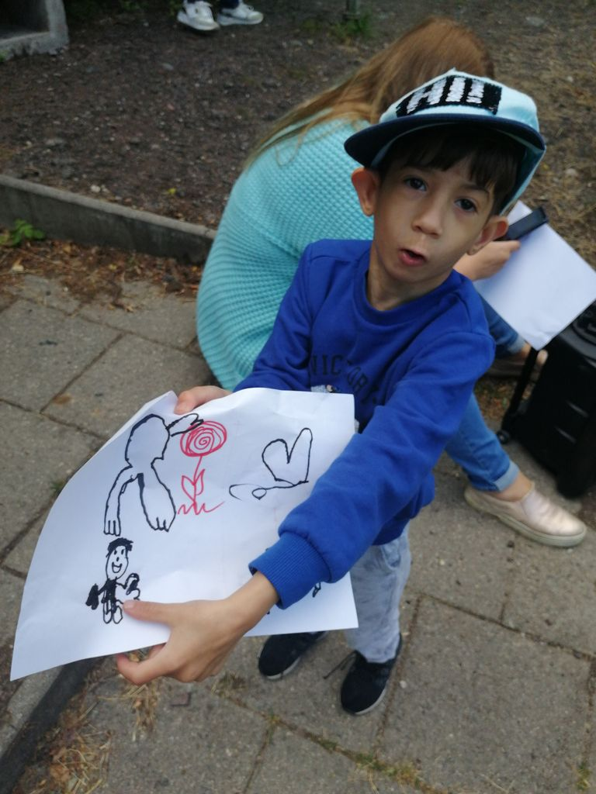
The Center organizes and implements:
Pre-school education
Primary and basic education
Secondary education through a social skills program
Vocational training
Day Social Care Centre
Carries out non-formal education of children (focuses on sports and art)
/

Slide 5
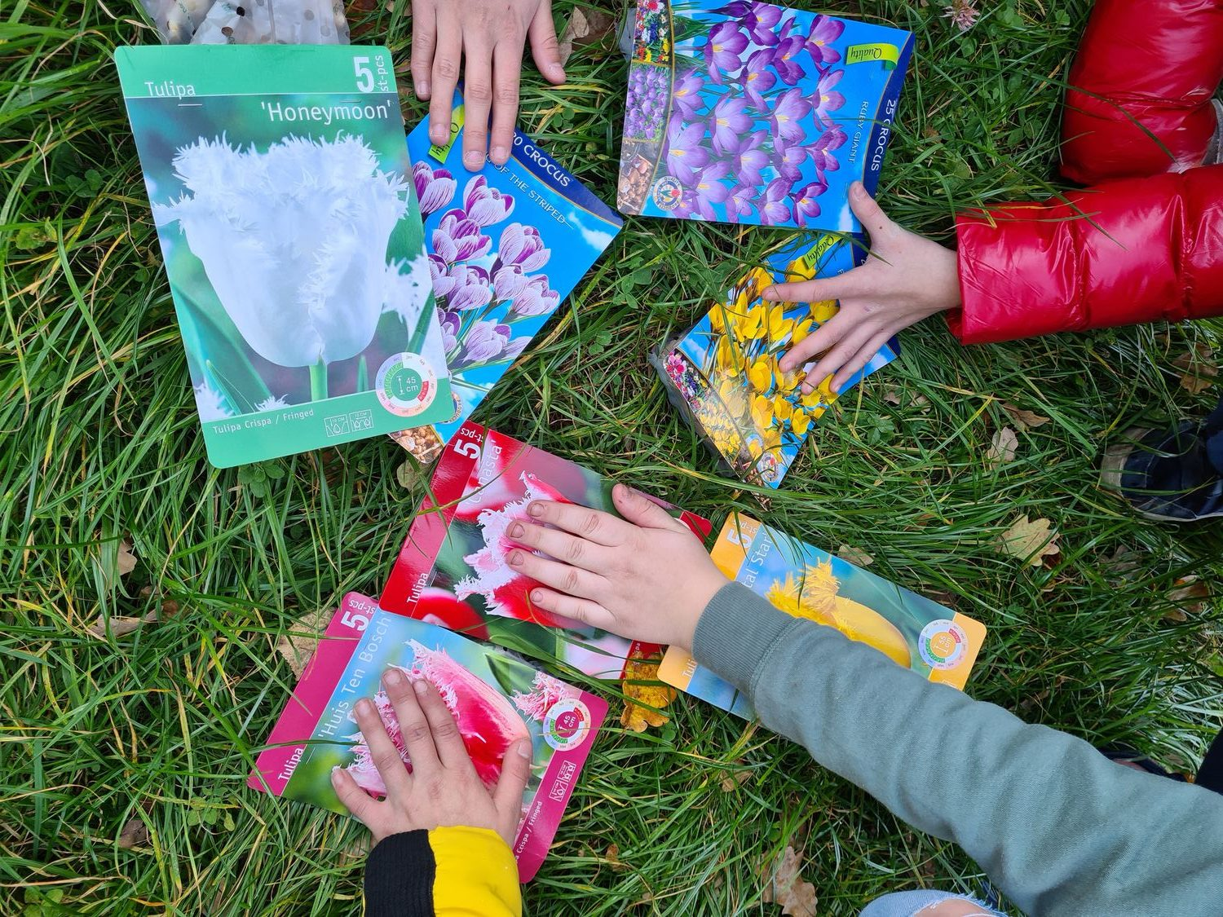
School
The student is taught according to individualized education
Teaching languages - Lithuanian, Russian and Polish
We carry out many different projects, mostly students like creativity exercises

Slide 6
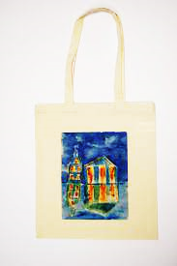
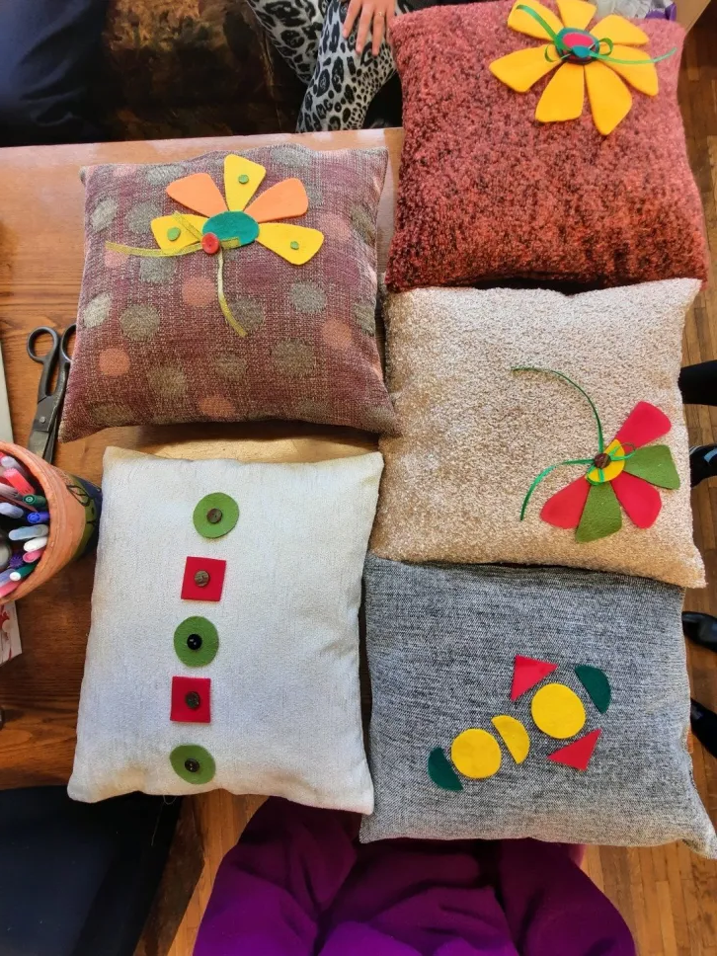
Vocational training
There are currently:
Manufacturer of fine textiles
Tailor - operator

Slide 7
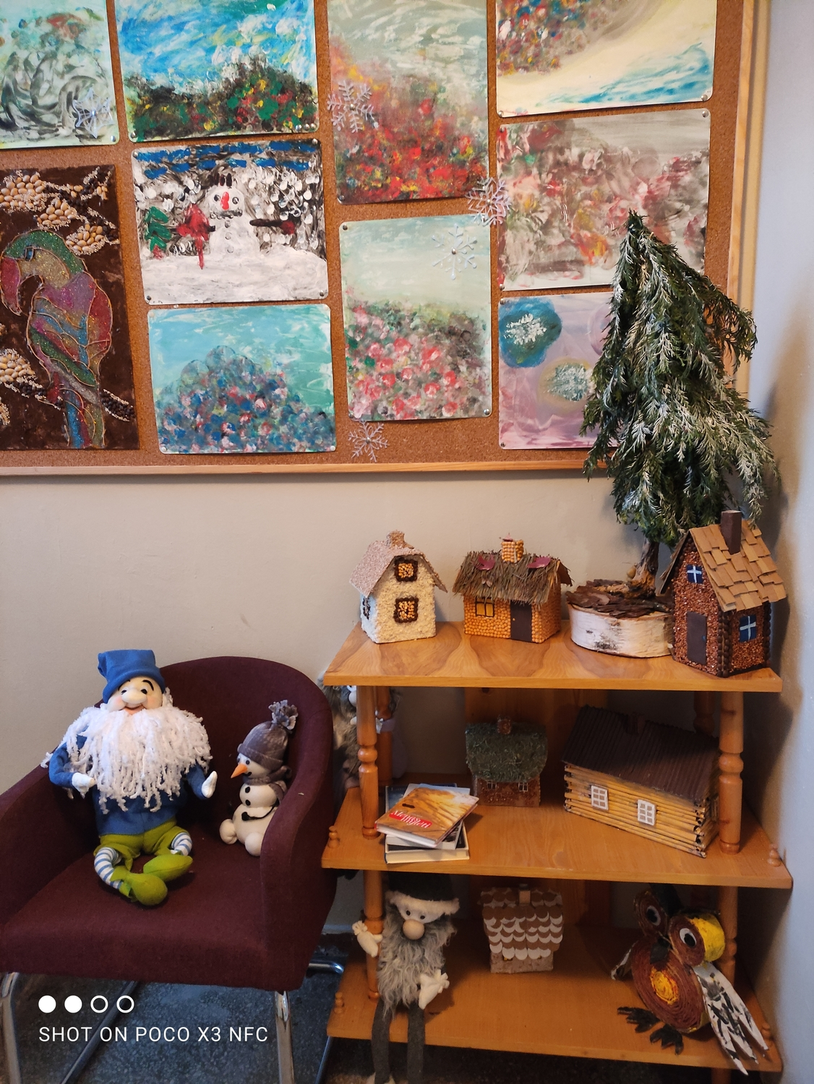
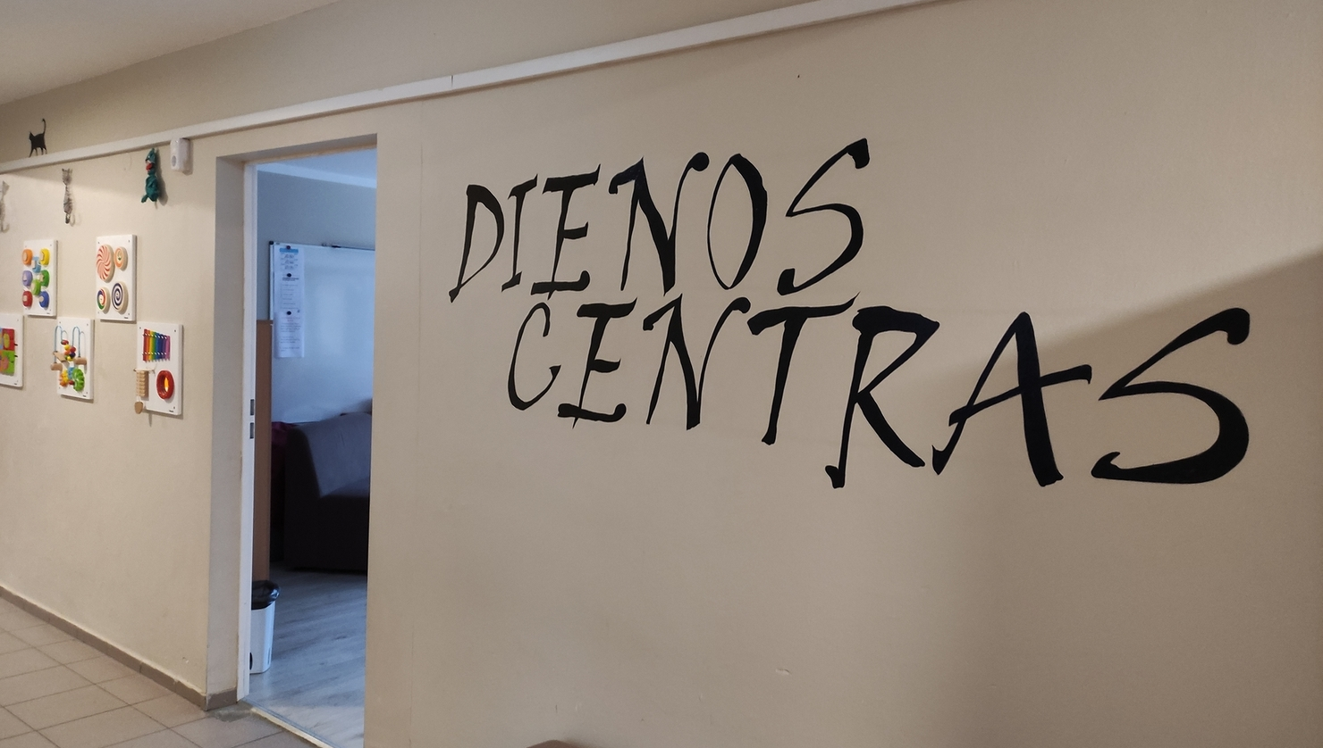
Day Social Care Centre
p.mActivities in progress:
handicrafts;
the arts;
pottery classes;
computer literacy;
cognitive skills support;
maintenance of daily self-management skills;
social skills support.
Working hours from 8 a.m t

Slide 8
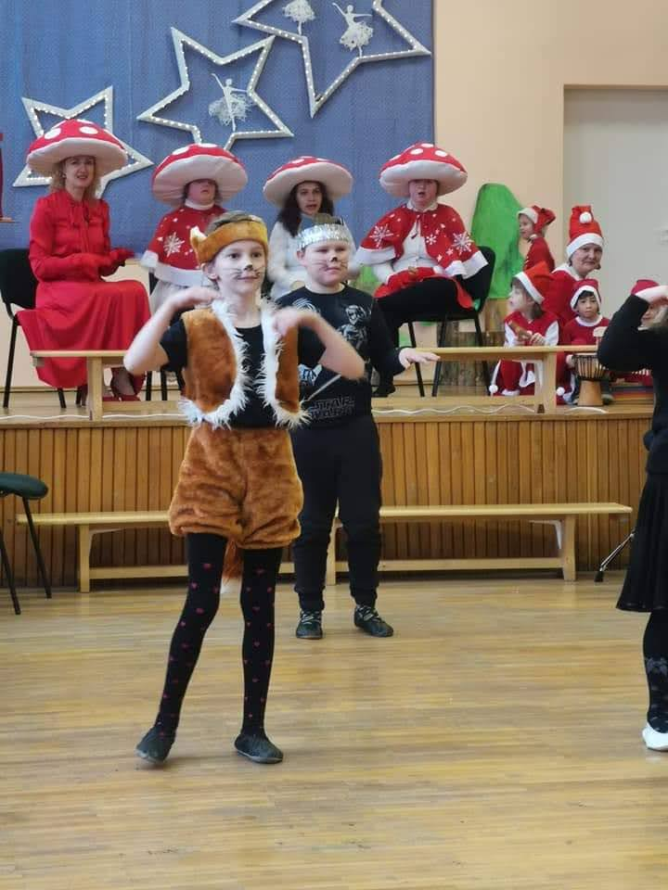
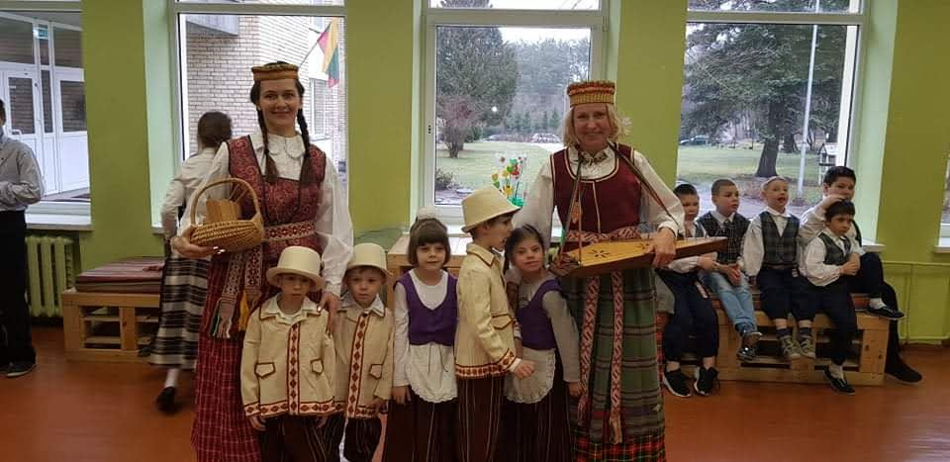
Educational process
The school pays a great deal of attention to developing general competencies of pupils, examples being communication, creativity, perception, fostering of national traditions and values).

Slide 9
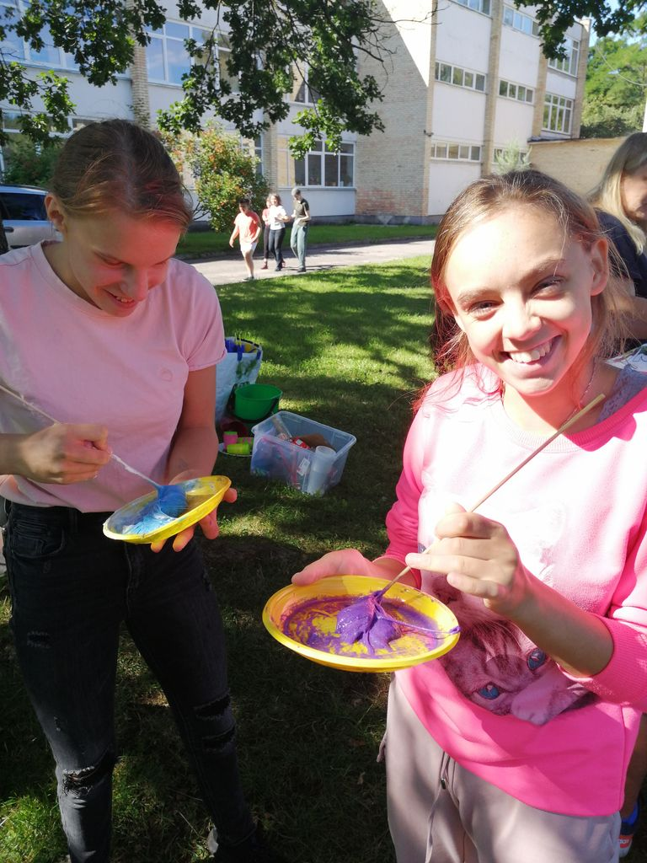
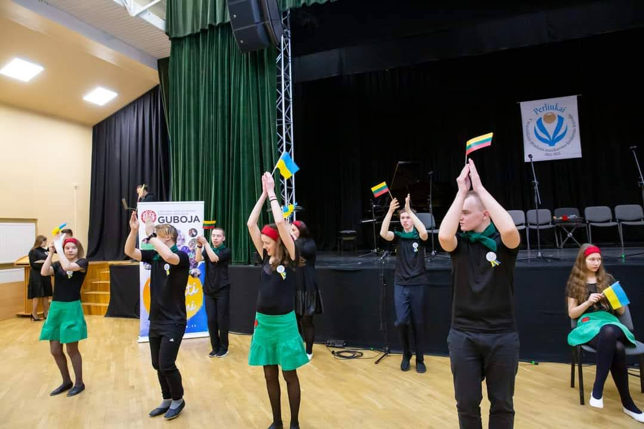
Artistic education
Artistic education is one of the schools’ primary focus points. Active artistic practices of pupils facilitate their integration into social environment. Students participate in concerts and exhibitions in various regional and national competitions every year.

Slide 10
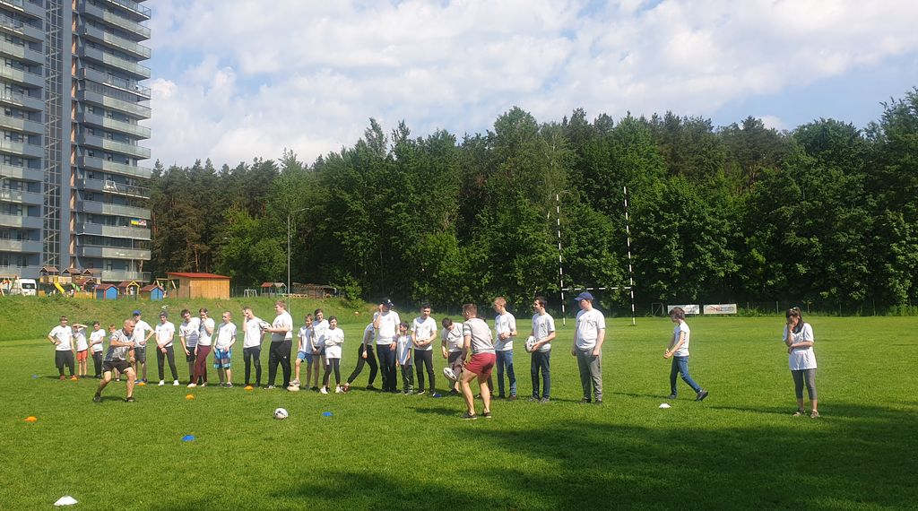
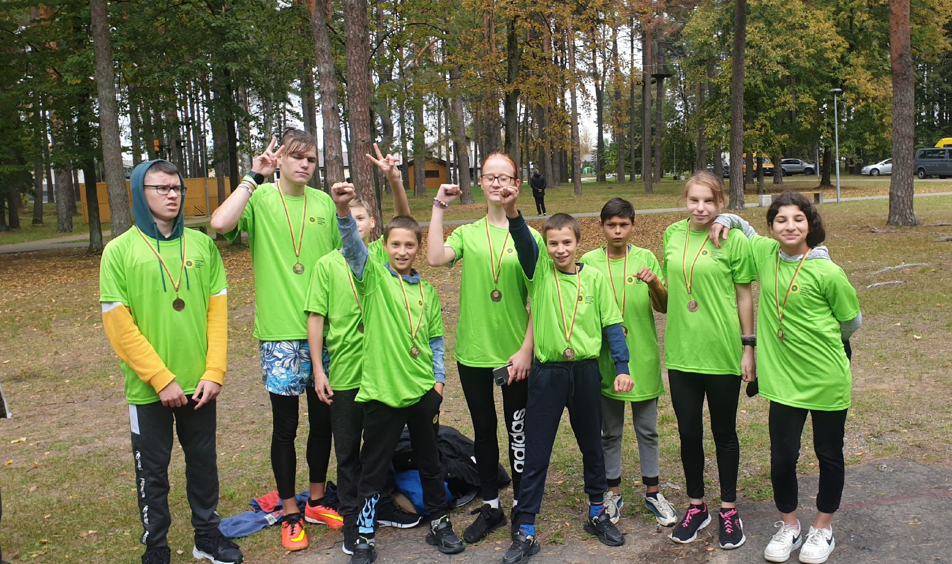
Health-promoting school
The school also concentrates on increasing the physical activity of students. The institution has received the status of health-promoting school.

Slide 11
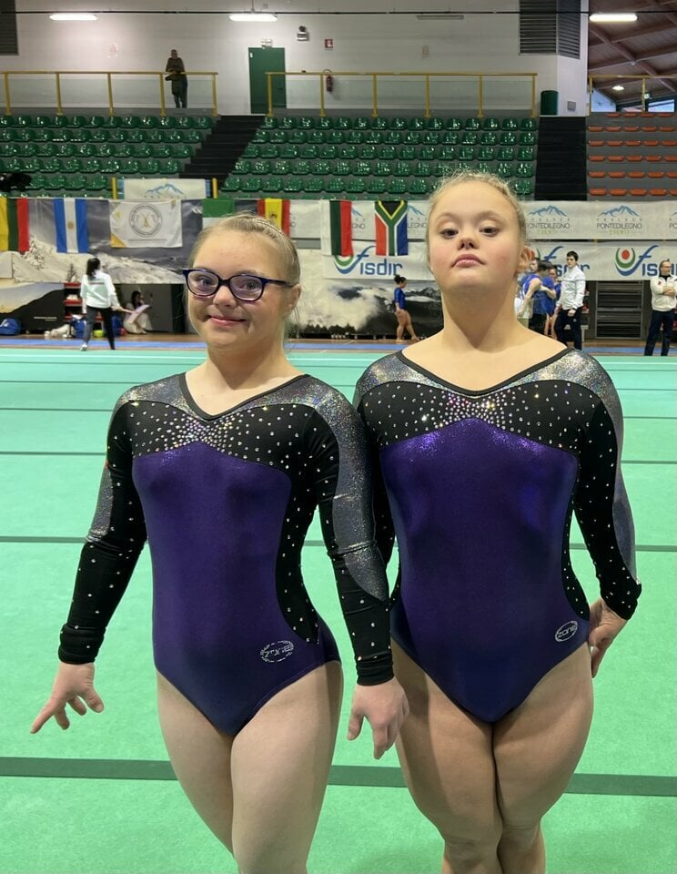
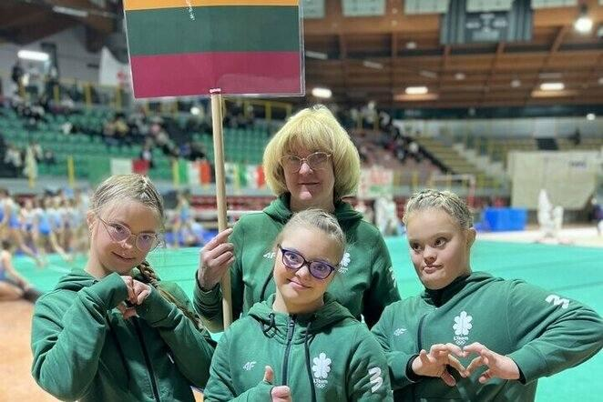
Sports competitions
Students participate in various national and international sports competitions. Diana is a student at the school who took 3rd place in the World Championship of acrobatic gymnastics for people with Down's syndrome.

Slide 12
PROJECT “MOSI LIFE”: MODELLING SITUATIONS FOR LIFE
We started the new Erasmus+ Youth Cooperation Partnership project "MOSI LIFE: Modelling Situations for Life“. Target group – youth from 13 till 16 with SEN ( special educational needs).
The main purpose is to model life situations, because students with SEN have no skills in their daily life. We have 9 topics: education, health, family, money, travel, hobbies, hygiene, food, friends ( fun) .
By the project we overcome difficulties in dealing with daily life situations, and therefore will improve their chances for better social inclusion possibilities.

Slide 13
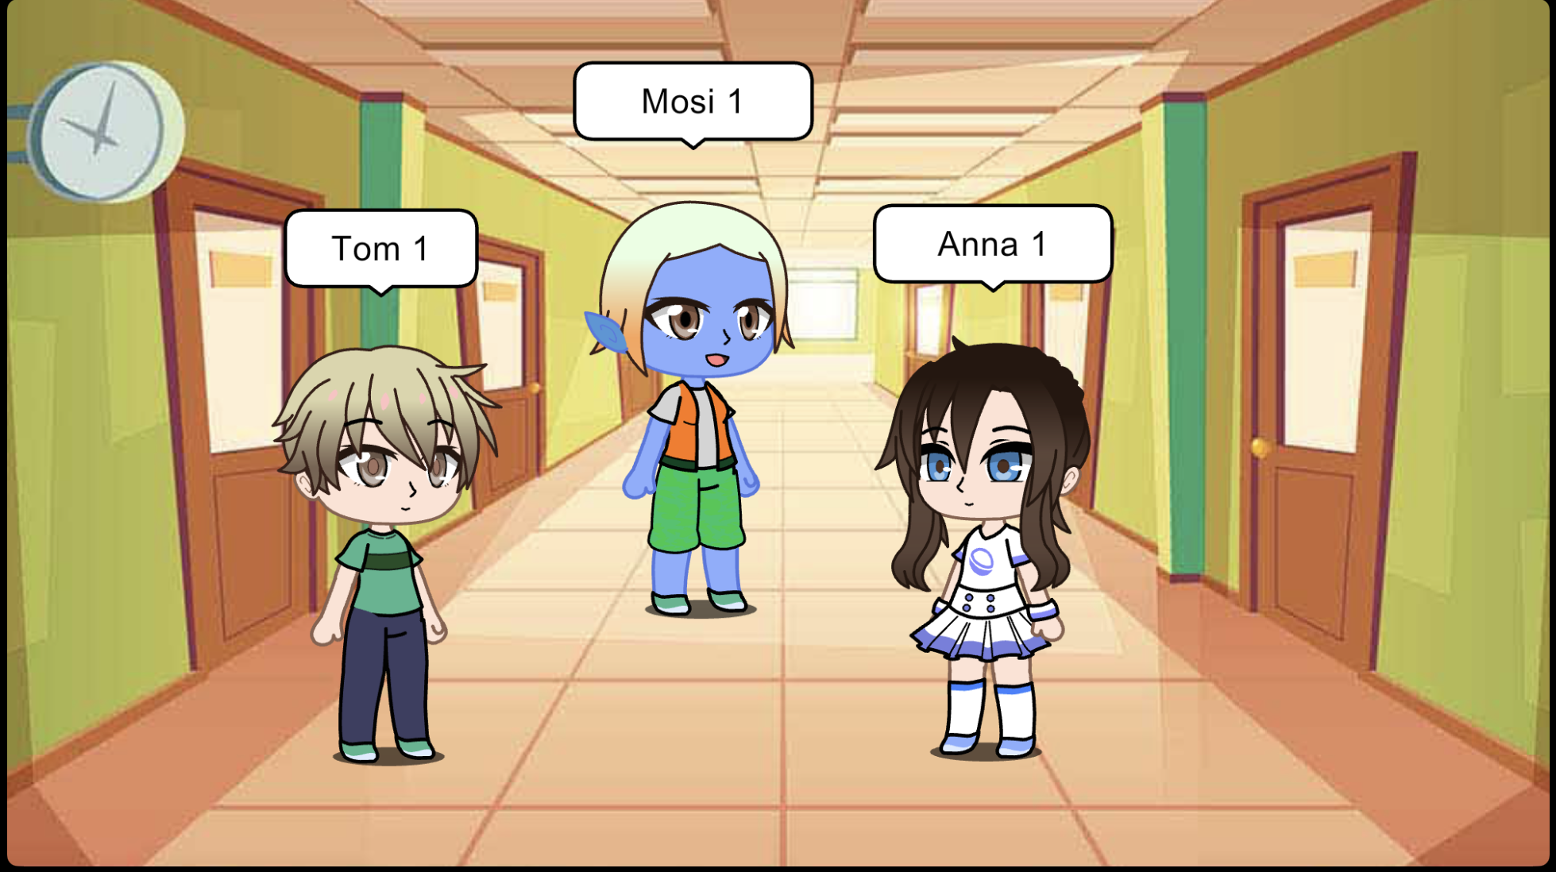
“MOSI LIFE” CHARACTERS

Slide 14
WHO IS MOSI? AND WHY IS MOSI?
Hello! My name is MOSI and I am so excited to meet you! I recently traveled to Earth from my planet Erasmusland. My dream was to see the most beautiful place in the whole galaxy and I got transported with my spaceship to Earth! I am so excited to be here, but I feel so lonely...
MOSI - fluffy character, no gender, very friendly, but doesn't know how to behave in Earth, how to act in a group of people and in different life situations.

Slide 15
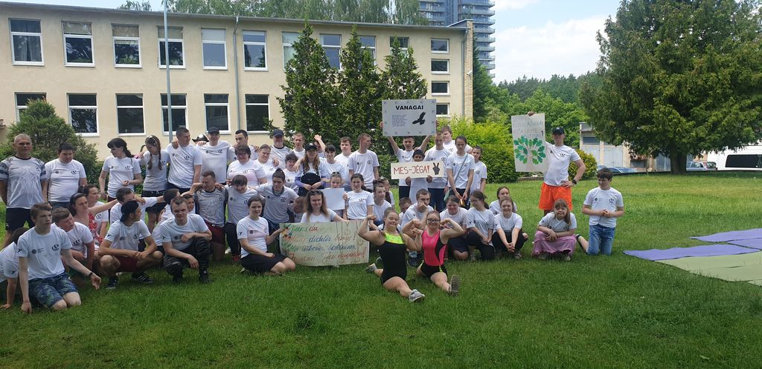
Thank you for your attention! ☺

