Slide 1
Renewable energy
By: Petra Gréta Szigyártó

Slide 2
What is Renewable Energy
It is the energy from a source that is not depleted when used, such as wind or solar power.
Renewable energy is energy generated from natural resources

Slide 3
Renewable Energy
There are 6 types of renewable energy sources:
Solar Energy
Wind Energy
Tidal Energy
Wave Energy
Geothermal Energy
Biofuels

Slide 4
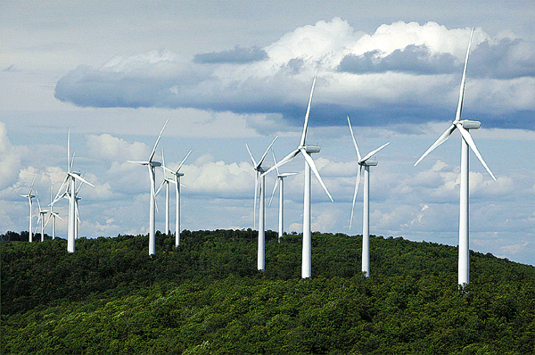
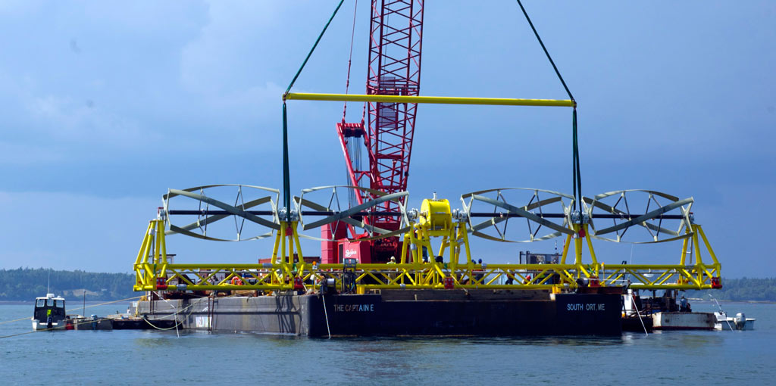
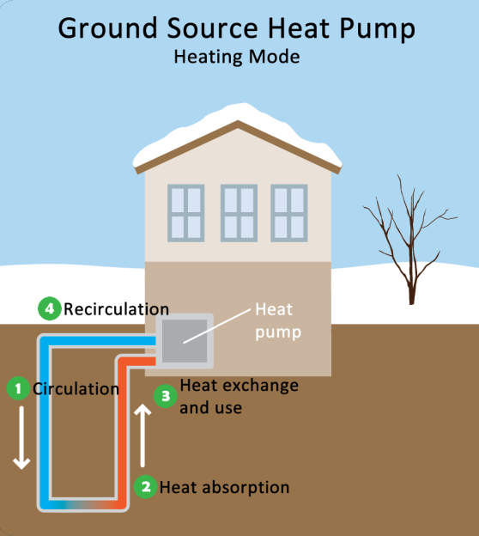
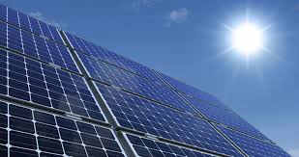
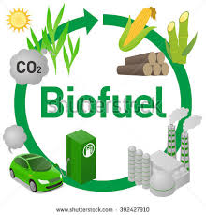
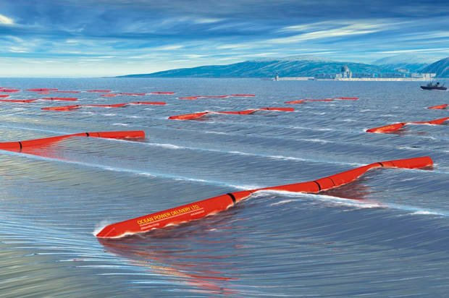

Slide 5
Solar Energy
We use solar thermal energy systems to
heat water for use in homes, buildings or swimming pools
heat the inside of homes, greenhouses and other buildings
heat fluids to high temperatures in solar thermal power plants
Solar photovoltaic devices or solar cells
change sunlight directly into electricity.

Slide 6
Wind Energy
Wind turbines operate on a simple principle. The energy in the wind turns two or three propeller-like blades around a rotor. The rotor is connected to the main shaft, which spins a generator to create electricity.
Wind turbines are mounted on a tower to capture the most energy. At 100 feet or more above ground, they can take advantage of faster and less turbulent wind.
Wind turbines can be used to produce electricity for a single home or building, or they can be connected to an electricity grid for more widespread electricity distribution.

Slide 7
Wind Energy
Advantages of Wind Energy
Clean and renewable source of power
Cost effective
Rapid growth of industry, large potential
Disadvantages of Wind Energy
Wind reliability
Threat to wildlife
Noise and visual pollution

Slide 8
Tidal Energy
Tidal Stream Generator
Makes use of the kinetic energy of moving water to power turbines, in a similar way to wind turbines that use wind to power turbines.
Tidal Barrage
Tidal barrages make use of the potential energy in the difference in height between high and low tides.

Slide 9
Tidal Energy
Advantages
Clean fuel source compared to fossil fuels
Domestic source of energy
Disadvantages
Tidal power can have effects on marine life.
The turbines can accidentally kill swimming sea life with the rotating blades.
Some fish may no longer utilize the area if threatened with a constant rotating or noise-making object.
Installing a barrage may change the shoreline within the bay or estuary, affecting a large ecosystem that depends on tidal flats.

Slide 10
Wave Energy
Ocean waves contain huge energy potential.
Wave power devices extract energy from the surface motion of ocean waves or from pressure fluctuations below the surface.

Slide 11
Wave Energy
Advantages
Renewable
Environmentally friendly compared to fossil fuel energy
Variety of designs to use
Disadvantages
Can affect the marine environment
May disturb private or commercial shipping
Dependent on wavelength for best operation
Poor performance in rough weather
Visual/noise issues

Slide 12
Geothermal Energy
Direct geothermal energy can be accessed in areas where hot springs/geothermal reservoirs are near the surface of the Earth.
Geothermal heat pumps utilizes a series of underground pipes, an electric compressor and a heat exchanger to absorb and transfer heat.
Geothermal power plants also use the heat of the Earth through hot water and steam. In these plants, heat is used to generate electricity.

Slide 13
Geothermal Energy
Advantages
Renewable energy
Cleaner than burning fossil fuels
Disadvantages
Cost of drilling, researching proper areas
Requires a suitable location

Slide 14
Biofuels
The two most common types of biofuels are ethanol and biodiesel.
Ethanol:
It’s an alcohol.
Ethanol is mostly used as a fuel additive to cut down a vehicle's carbon monoxide and other smog-causing emissions.
Biodiesel
Biodiesel is made by combining alcohol (usually methanol) with vegetable oil, animal fat, or recycled cooking greases.
It can be used as an additive to reduce vehicle emissions (typically 20%) or in its pure form as a renewable alternative fuel for diesel engines.

Slide 15
Biofuels
Advantages
Easy to source
Renewable
Reduces greenhouse gases
Disadvantages
Higher cost of production (lower supply than gasoline)
Monoculture
Shortage of food
Water Use

