Slide 1
The importance of Water
Boglárka pál
8. b

Slide 2
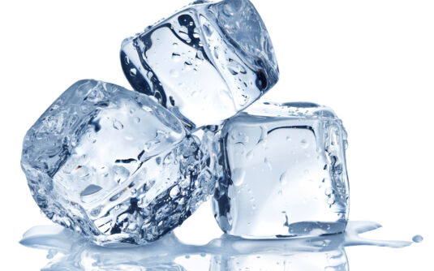
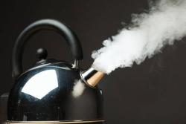
What is water?
Water is a colourless, odorless, tasteless liquid.
The good taste of drinking water is caused by other materials in it.
Water is the only natural thing on Earth that can be found in all three states.
In its solid state: ice
In gaseous state: water vapor

Slide 3
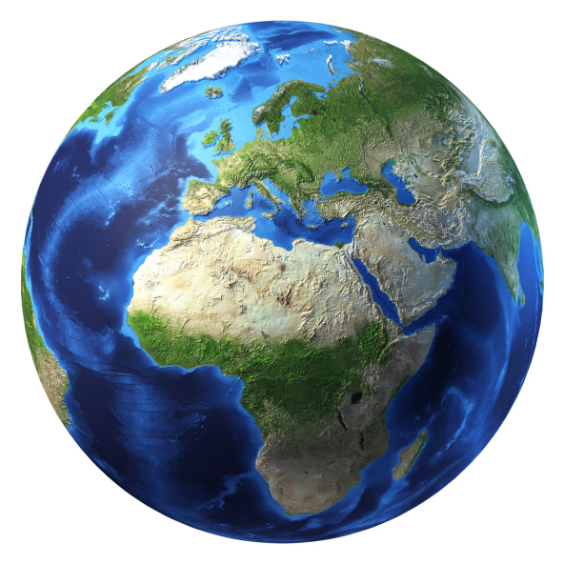
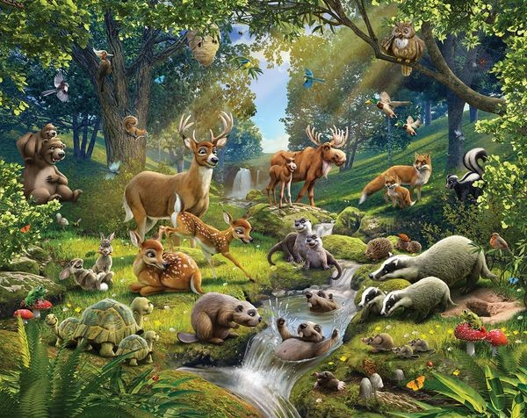
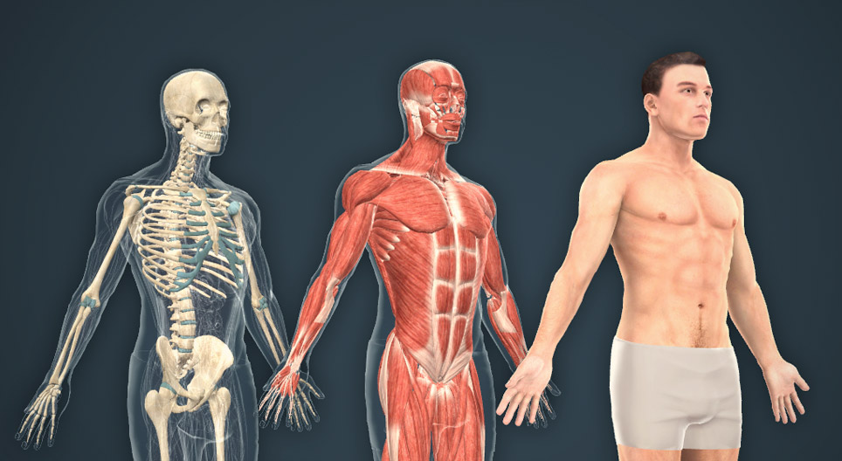
Water is a basic element of life
EARTH:
71% of the Earth is covered by water: approx. 2.5% is fresh water, the rest is salt water.
98% of fresh water is groundwater.
ANIMALS AND PLANTS:
An essential part of plants and animals.
HUMAN:
The largest part of the human
body is water.

Slide 4
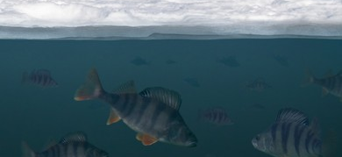
The biologic importance of water
Life on Earth is impossible without water, because the cells contain a lot of water.
Underwater animals can survive the freezing weather: only the top of the lakes freeze, so the animals don’t freeze in the lower parts.

Slide 5
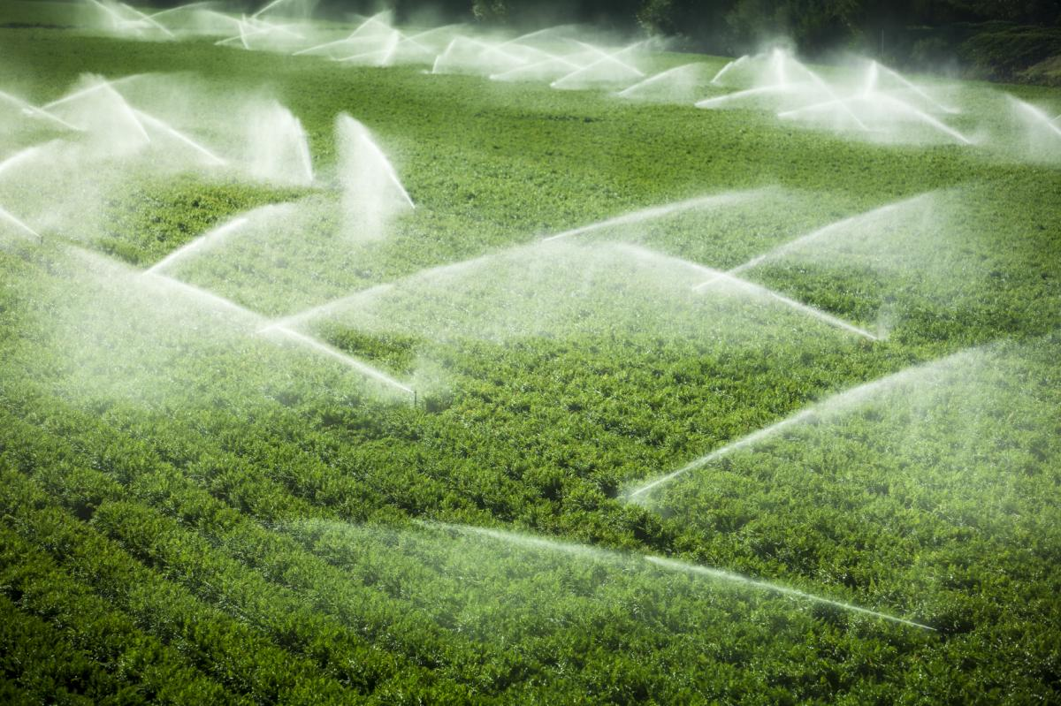
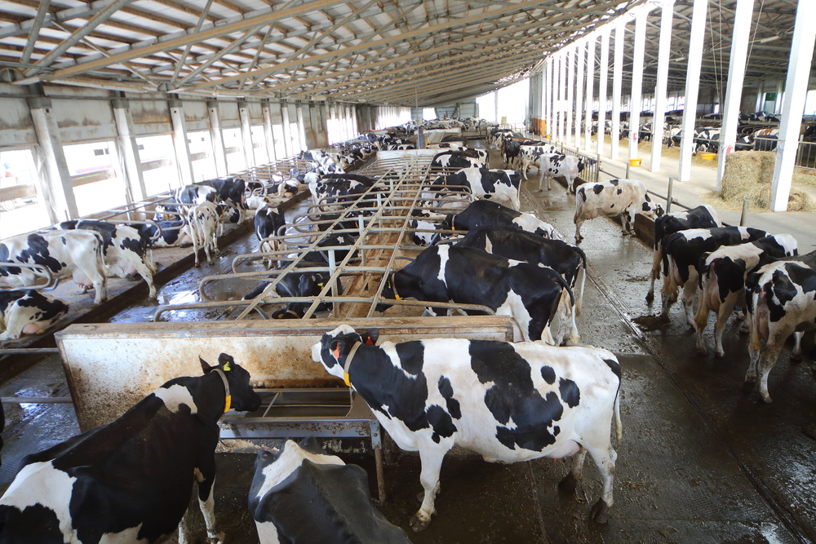
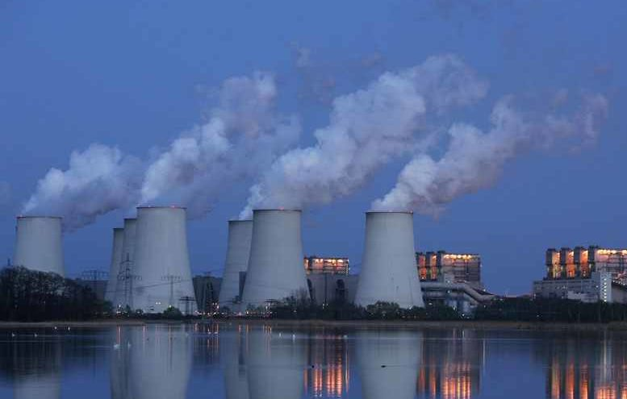
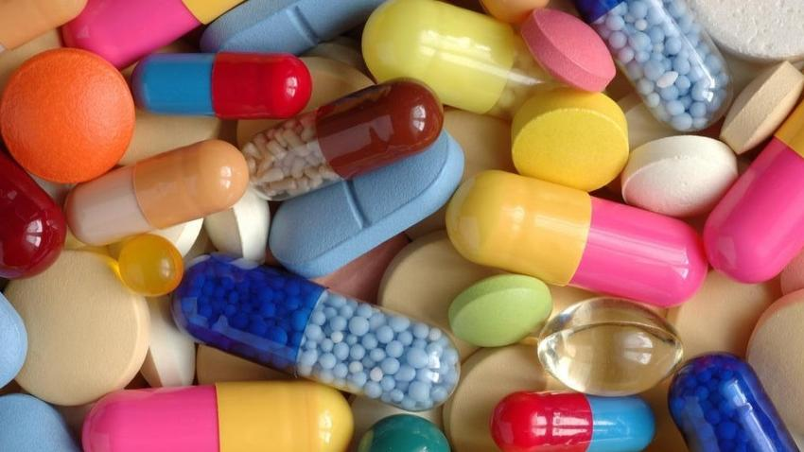
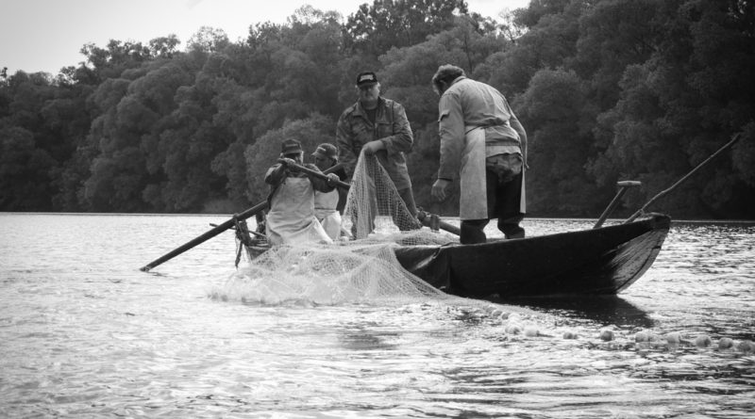
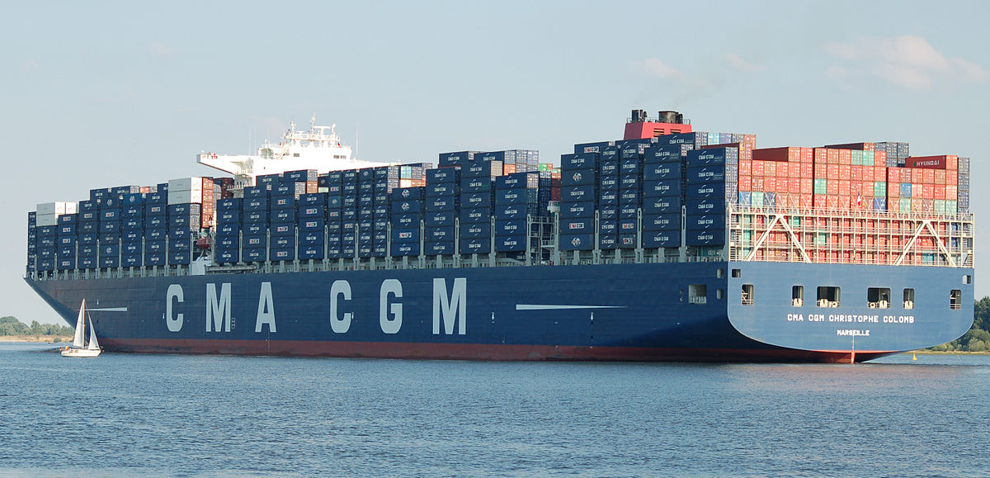
The econimic importance of water
Cultivation of plans: watering
Animal husbandry: watering, cleaning
fishing
Power plants
Chemical and pharmaceutical industry
Water transportation

Slide 6
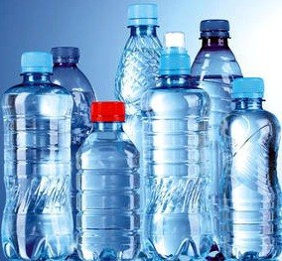
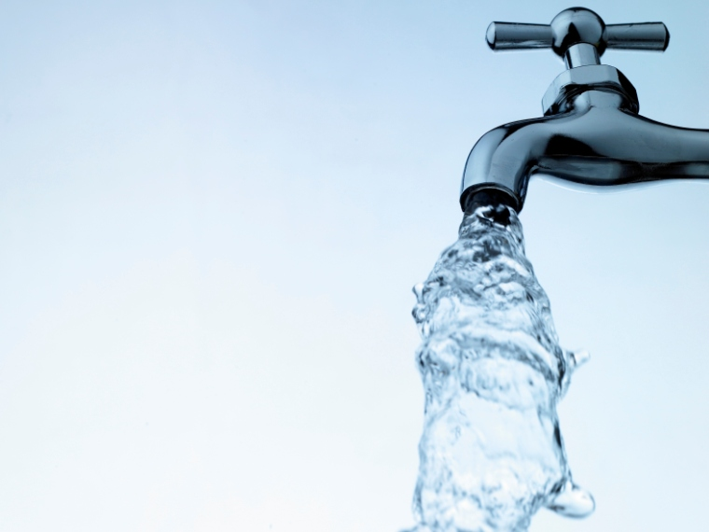
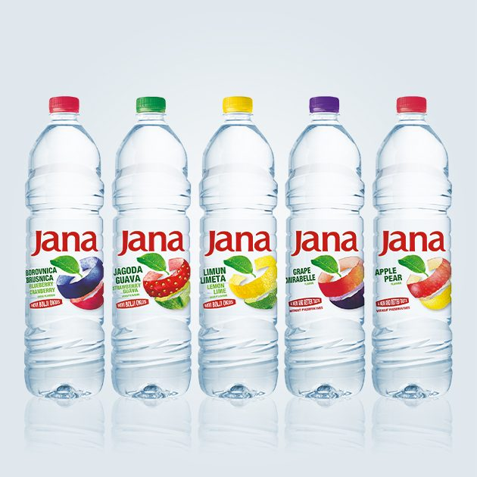
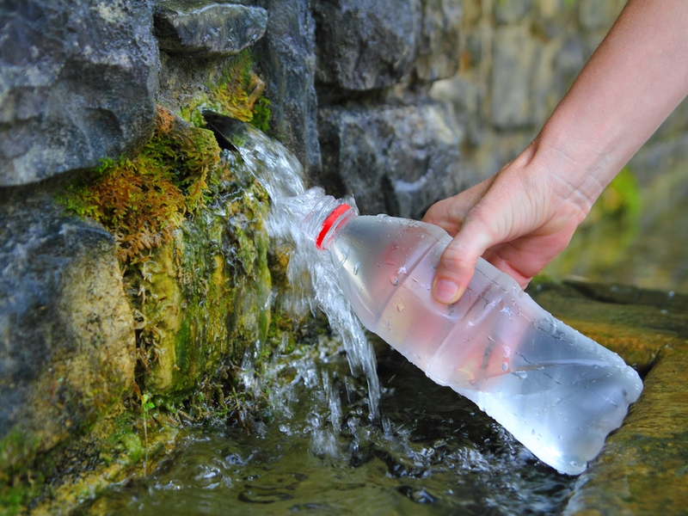
Drinking water
TYPES:
Wired drinking water
Bottled drinking water
Spring water
Natural mineral water
Flavored water

Slide 7
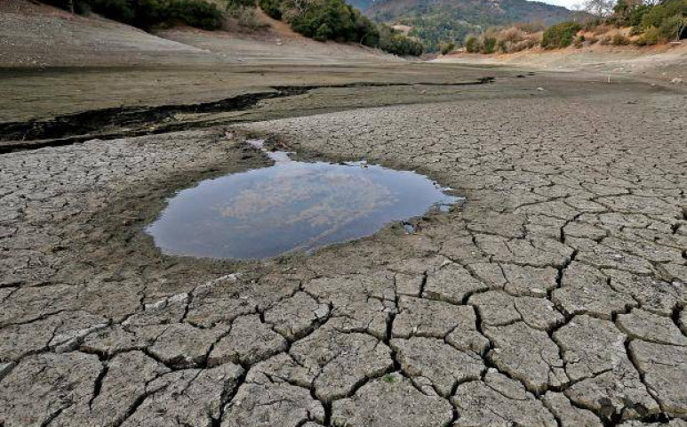
One of the biggest problems of our time is the lack of drinking water.
The amount of drinking water is drastically decreasing.

Slide 8
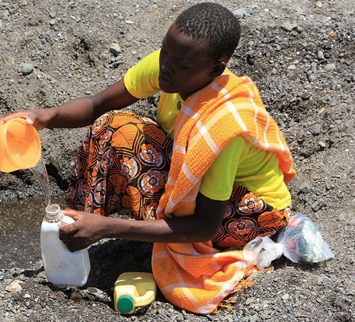
How long can human live without water?
According to doctors, people can live without water for only 2-3 days.

Slide 9
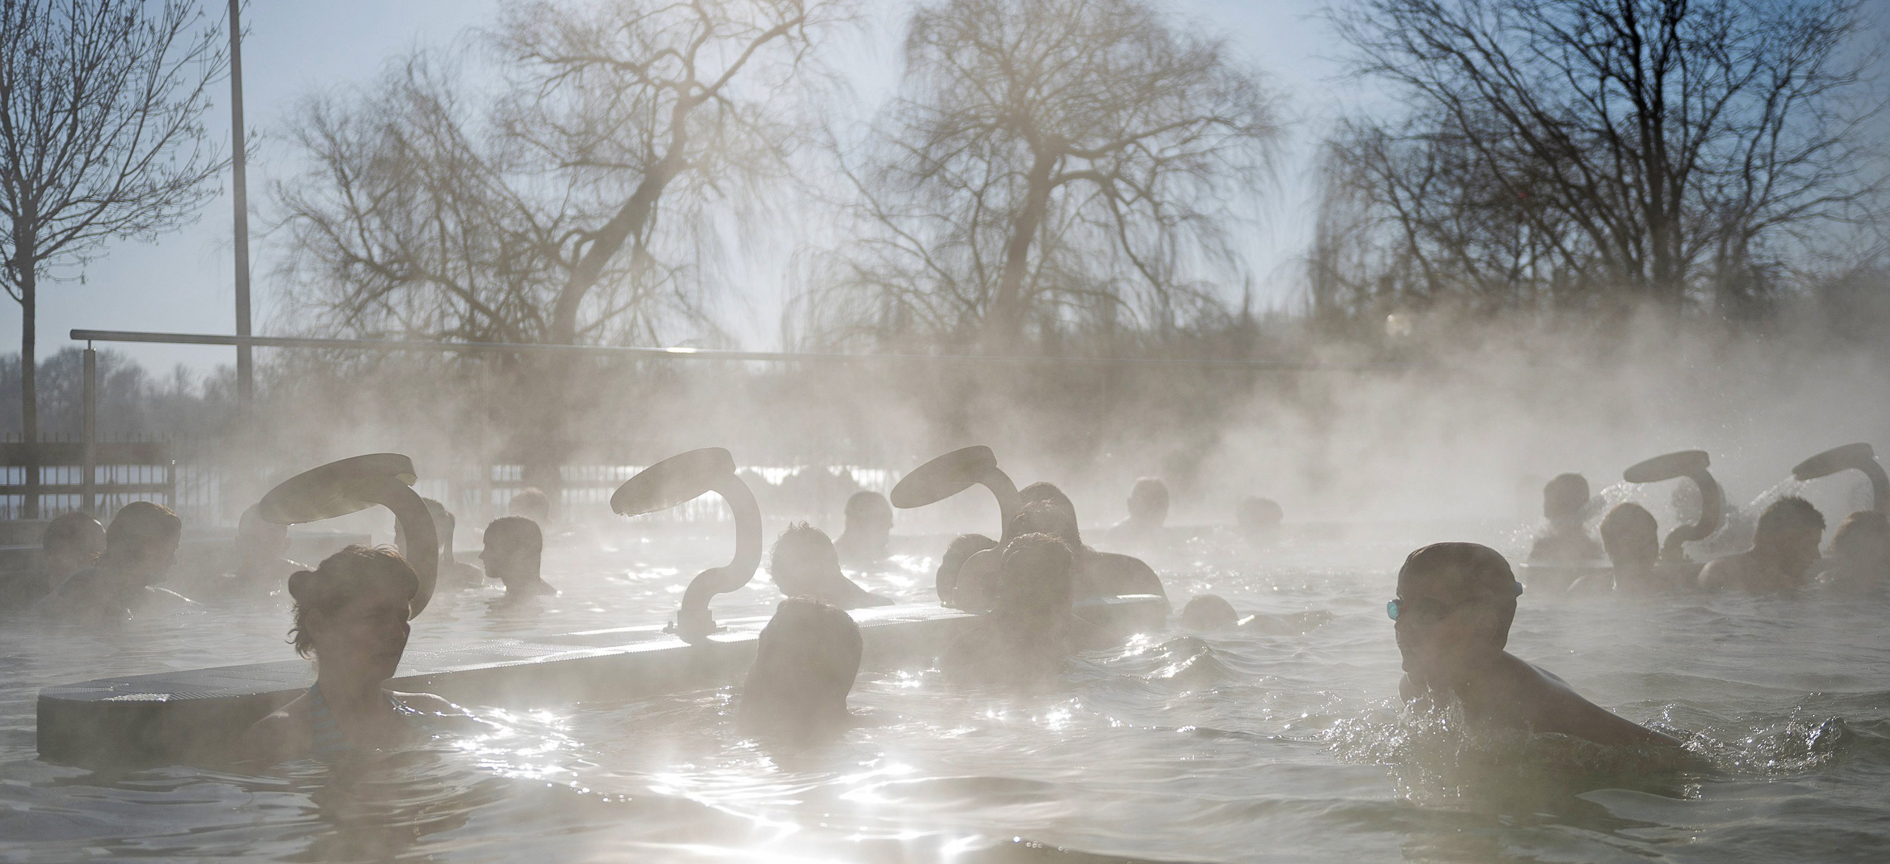
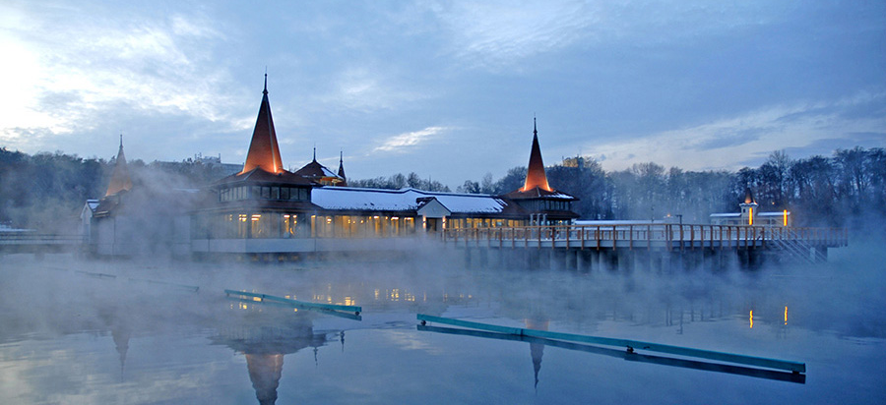
hungary
Hungary is rich in thermal water.
Dringing
Watering plants
Heating buildings
Thermal tourism

Slide 10
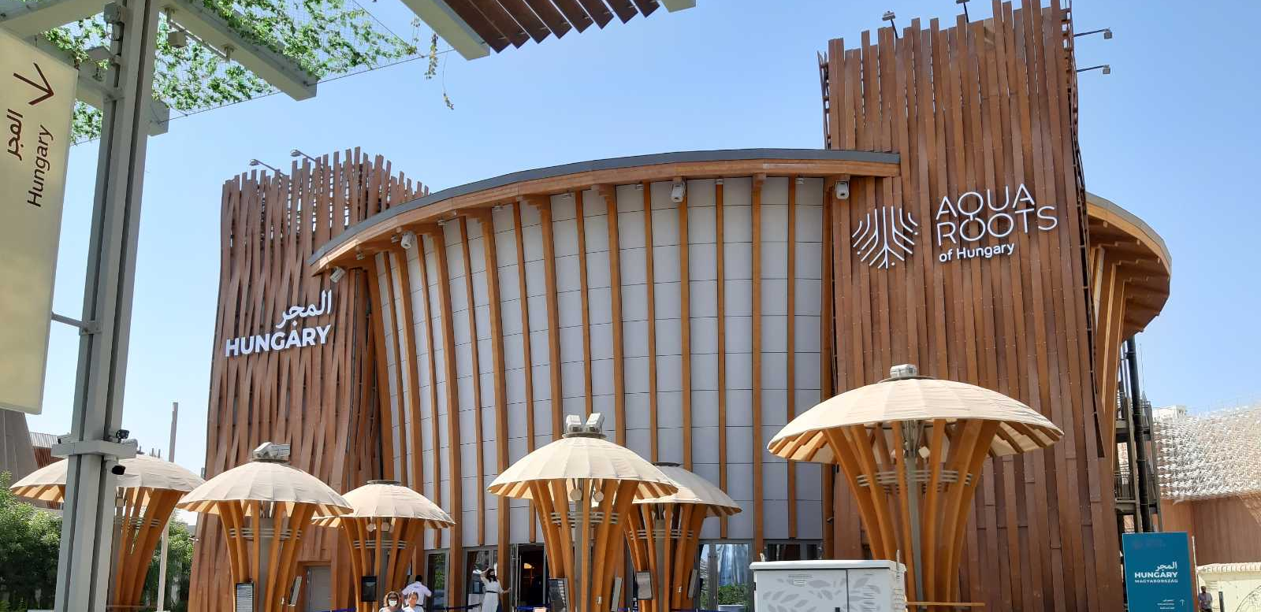
Thermal tourism was the topic of hungary on dubai word expo 2020

Slide 11
Word water day: 22 march
Since 1993
Its purpose is to draw attention to the importance of clean water available to everyone and the danger of fresh water resources.
https://www.worldwaterday.org/

Slide 14
Thank you for your attention!
Boglárka pál

