Slide 1
Balaton Uplands

Slide 2
Hegyestű Geological Visitor Site

Slide 3
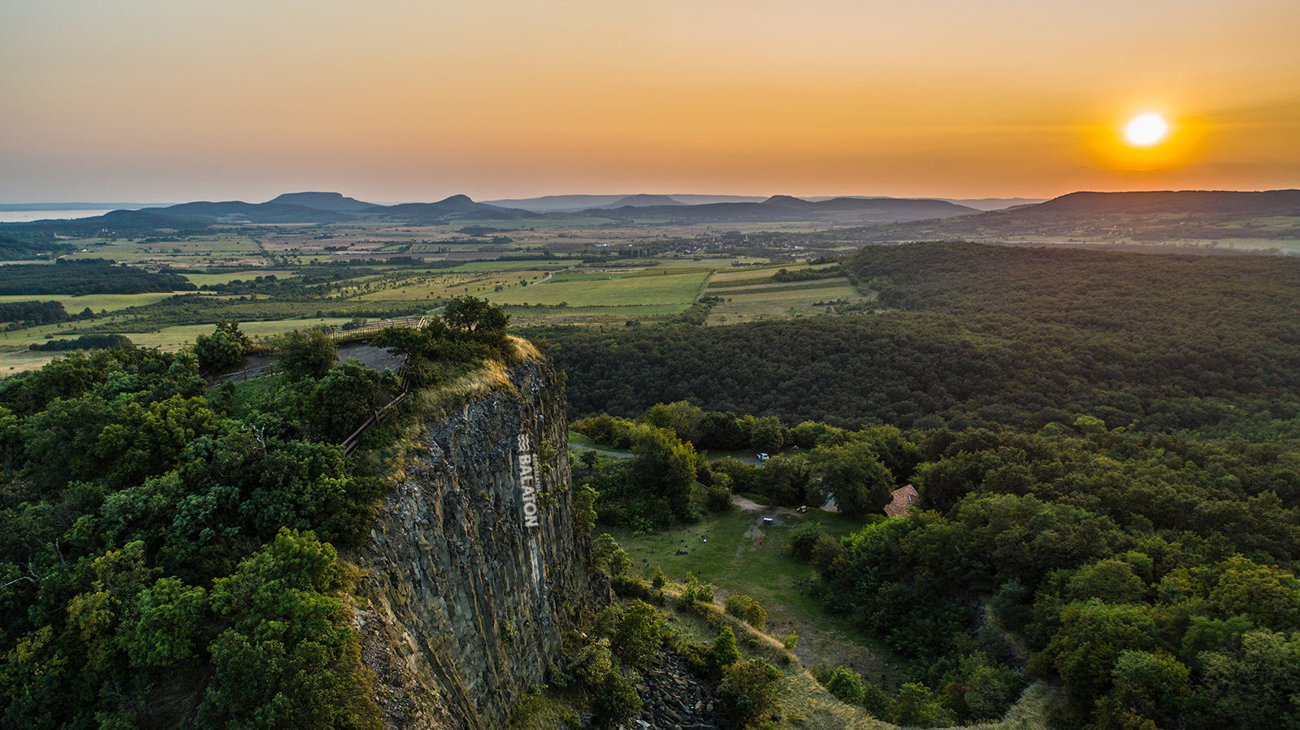
Hegyestű Geological Visitor Site
Hegyestű can be found between Zánka and Monoszló reaching as high as 337 metres
50-metre high mine-wall reveals the inside of the basalt volcano which was active 8 million years ago
This sight is unique in Hungary and it is a rare spectacle also in Europe

Slide 4
Salföld

Slide 5
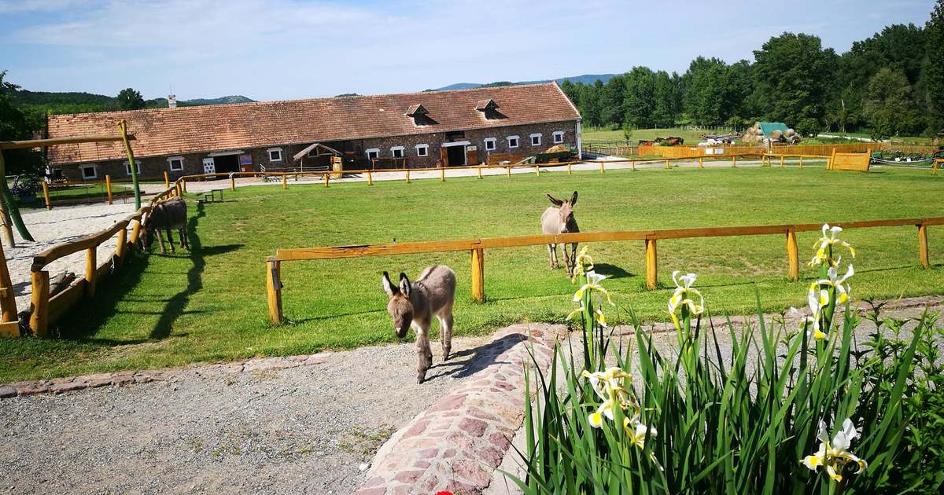
Salföld
Manor on the outskirts of the village keeping traditional Hungarian breeds of farm animals

Slide 6
Lóczy Cave

Slide 7
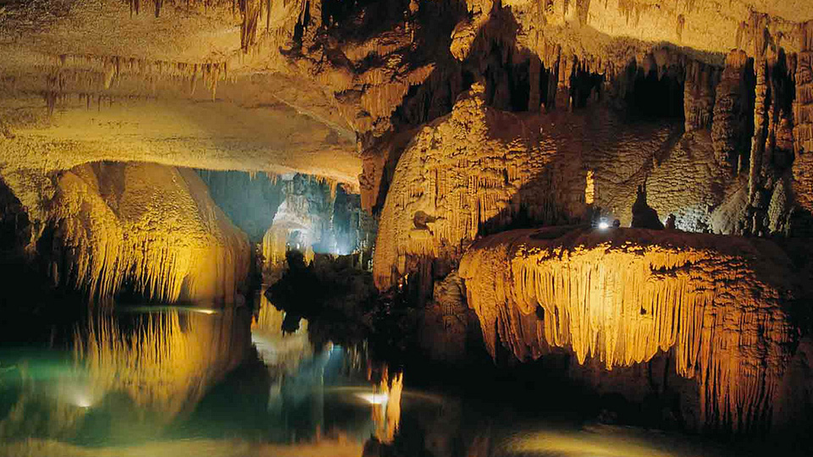
Lóczy Cave
The cave was found in 1882 and was opened to the public in 1934
The cave has limestone layers,

Slide 8
Lavender House Visitor Center

Slide 9
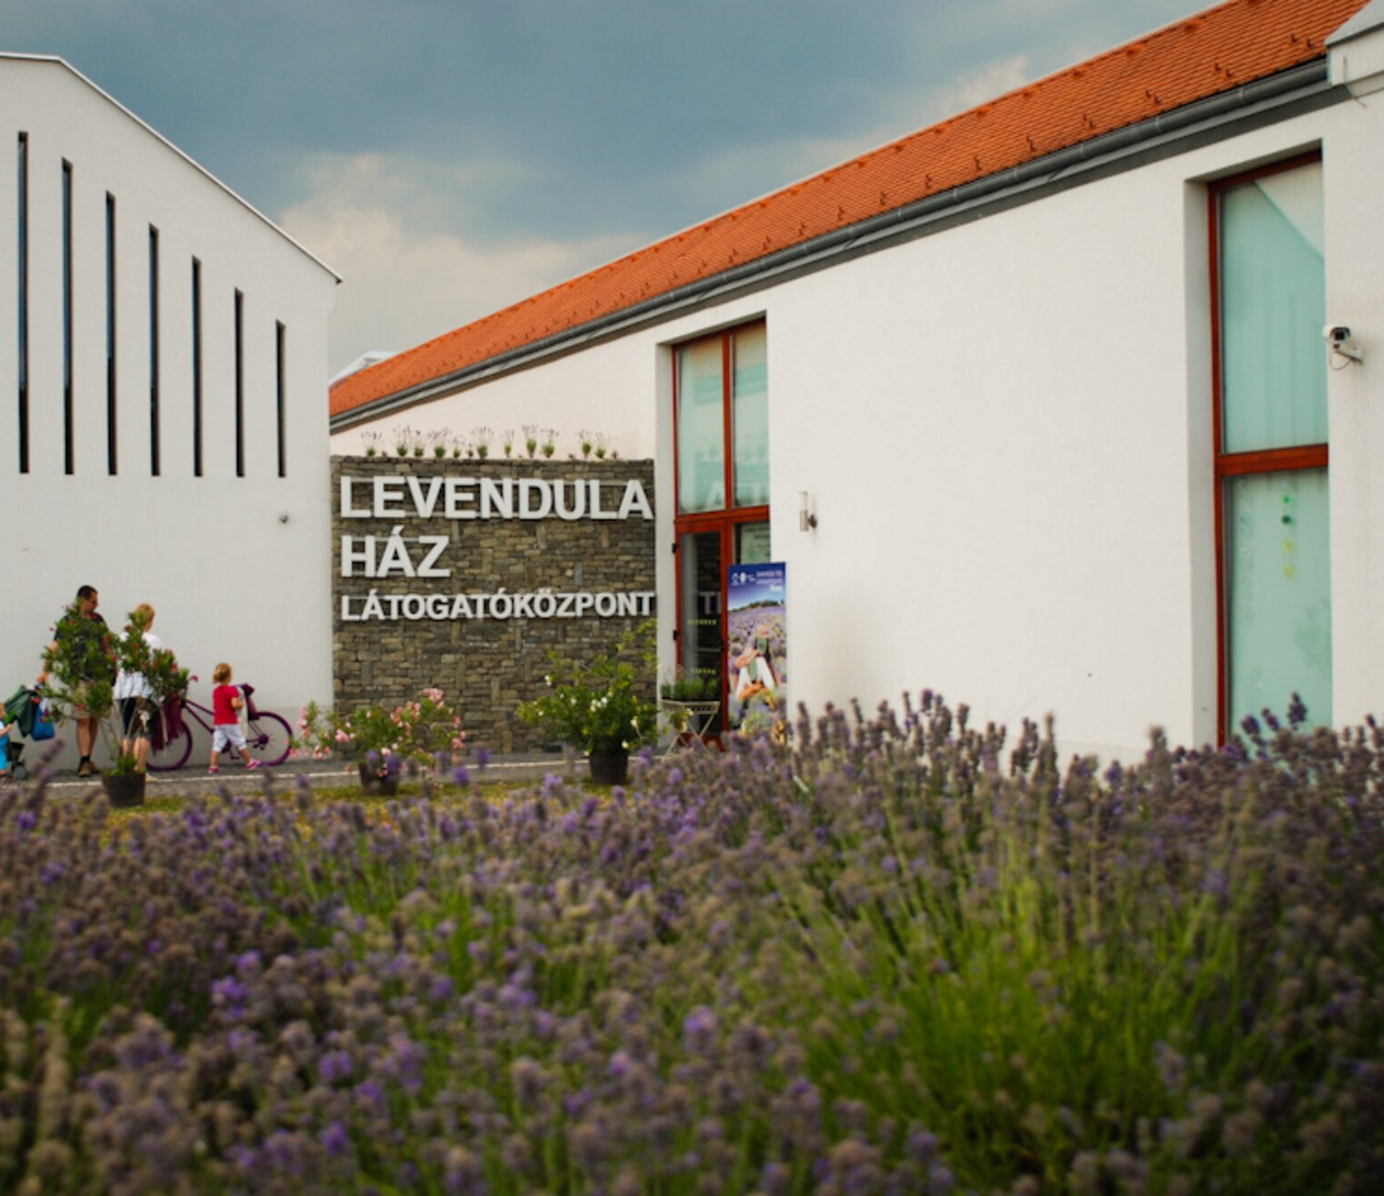
Lavender House Visitor Center
The Lavender House Visitor Centre –presents Tihany Peninsula in a way that provides special entertainment for young and old alike
The once raging fire of the volcanoes and the harmony of the landscape that was shaped as a result

Slide 10
Tapolca Lake Cave Visitor Centre

Slide 11
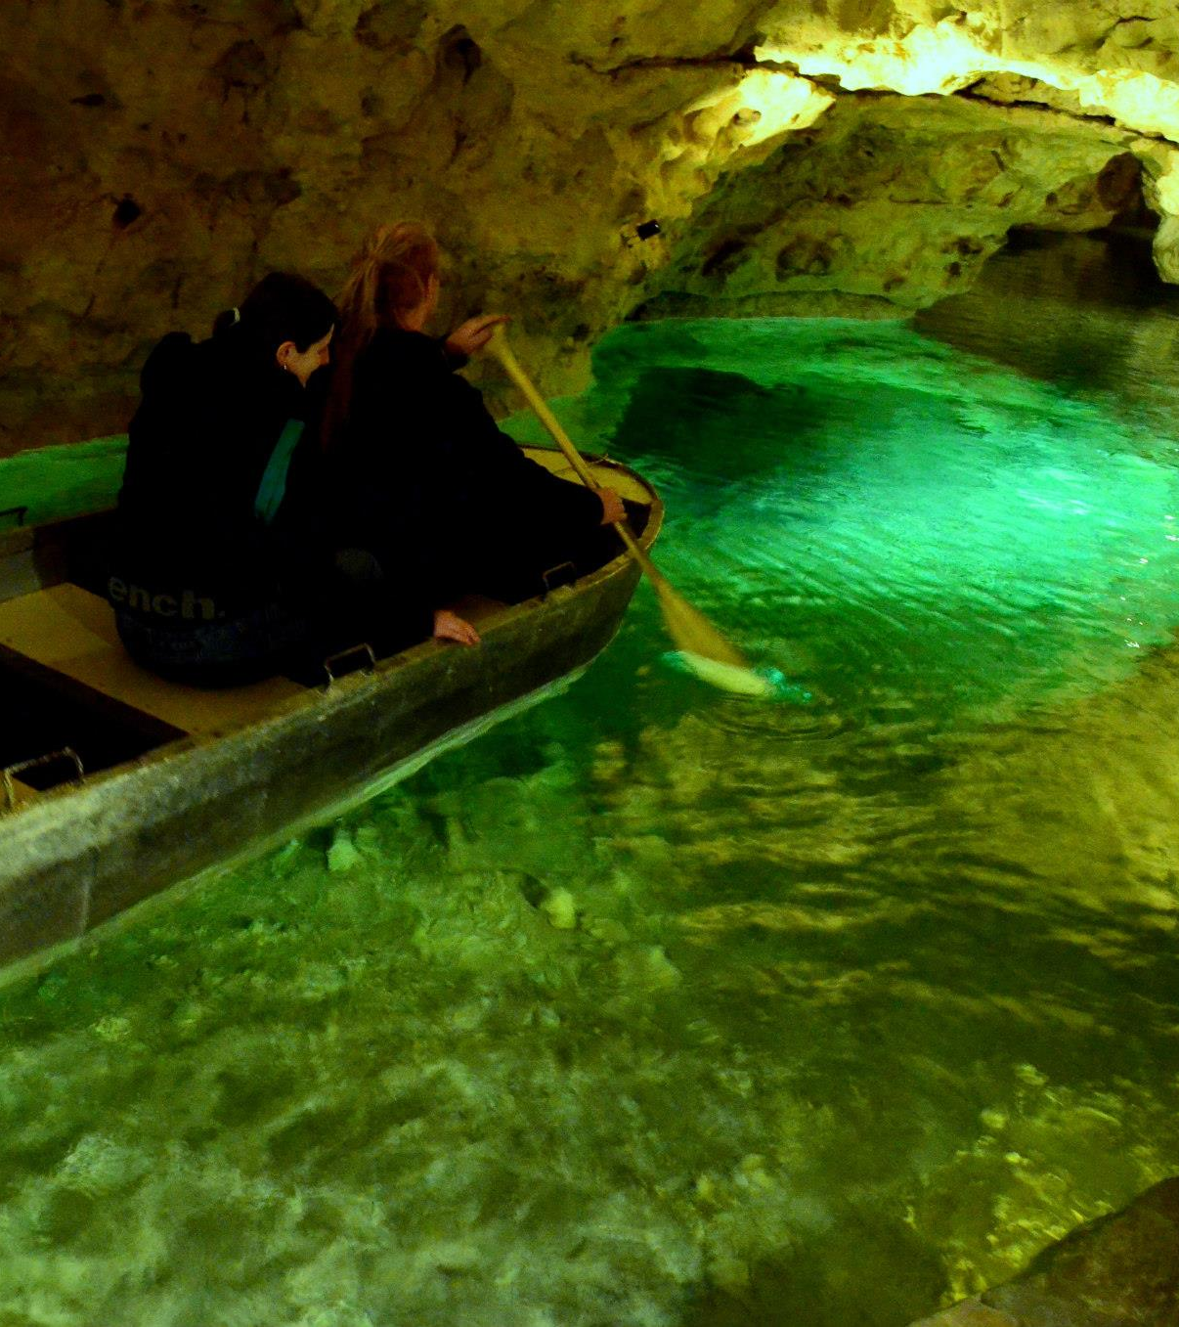
Tapolca Lake Cave Visitor Centre
This cave is hiding under the streets and houses of Tapolca, a little town not far from Balaton
In the strictly protected cave, which was discovered more than 100 years ago, the visitors can make a unique boat trip here

