Slide 1
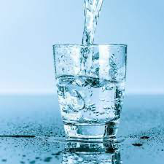
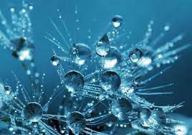
The importance of water in our life

Slide 2
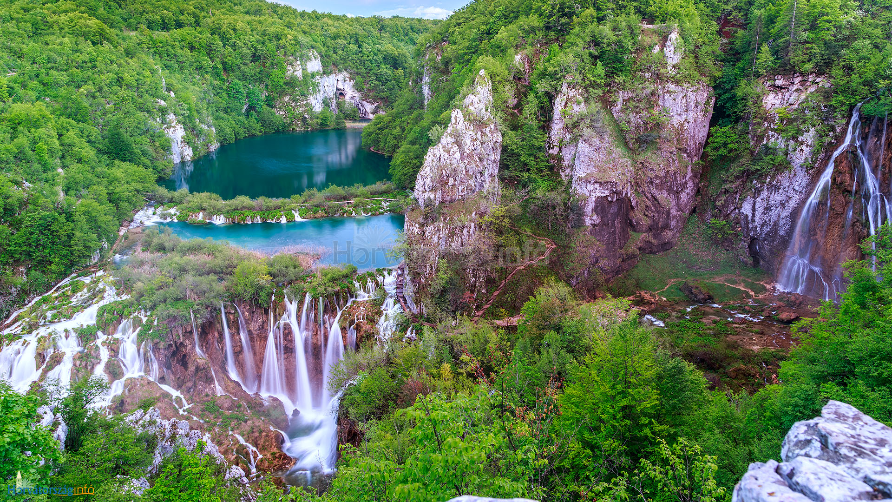
Introduction:
Highly required natural resource for life on earth.
The importance of water cannot becompared with anything else.
There is no alternative for water.
Water is the most important liquid on earth

Slide 3
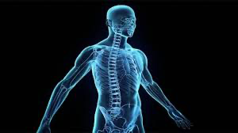
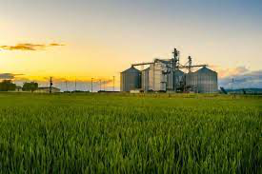
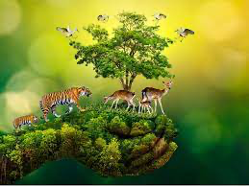
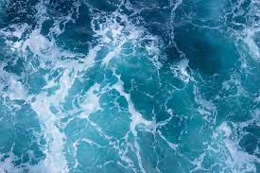
Several aspects:
Human body
Plants and animals
Agriculture
Industry
Washing, cooking needs water
Holiday

Slide 4
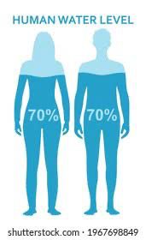
Human body 70% water
Cells need water
Water helps keep your temperature normal
Water helps to digest our food and get rid of wastes

Slide 5
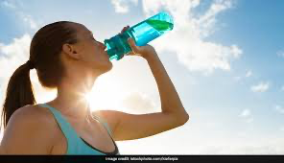
Benefits of drinking water
Better skin
Digestion
Brain works better
Gives energy
Weight loss

Slide 6
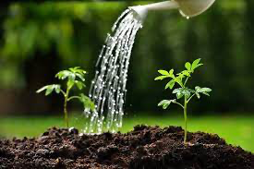
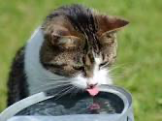
Plants and animals
Without water they cannot exist.
We like them and they are ours so we gotta take care of them.

Slide 7
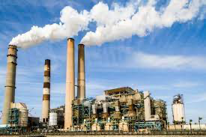
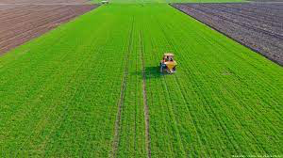
Industry and agriculture
Farms need water to produce crops and livestock
Factories need water to make many products
Water is used in power plants that make electricity

Slide 8
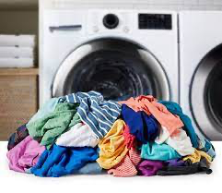
Household
Everyday household duties like washing and cooking needs water.
Let’s think about India or other poor countries to imagine how would be our daily routine without water.

Slide 9
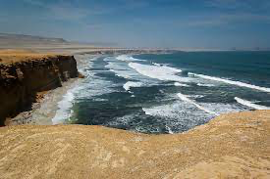
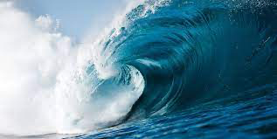
Holiday
In summer we like to go to lakes and seas. The water helps us to cool down and relax.
We also have a lot of water sports and leisure activities.

Slide 10
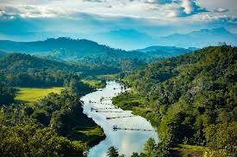
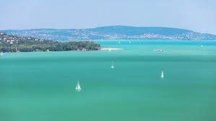
Water
Only a very small amount of all water is usable.
We got water from rivers, lakes, oceans but humans are polluting all the water at a great level.
We need to understand the importance of water. We must use water very carefully.

Slide 11
NO water=NO life
That is why sientists are looking for new planets with water,
they know this fact.

Slide 12
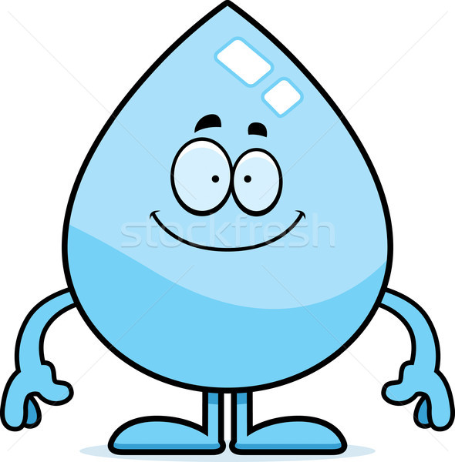
Thank you for your attention! Lola Mosolygó☺

