Slide 1
Light painting

Slide 2
Is it light painting or not?

Slide 3
…no. This is an illuminated object. Light painting needs some dynamics.

Slide 4
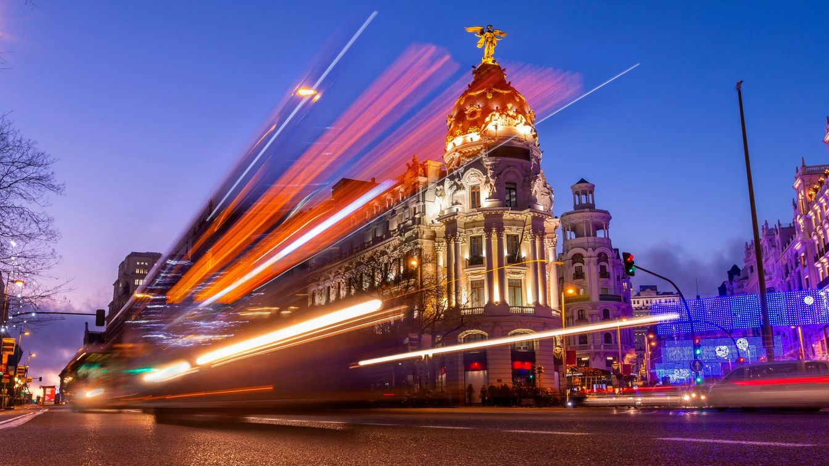
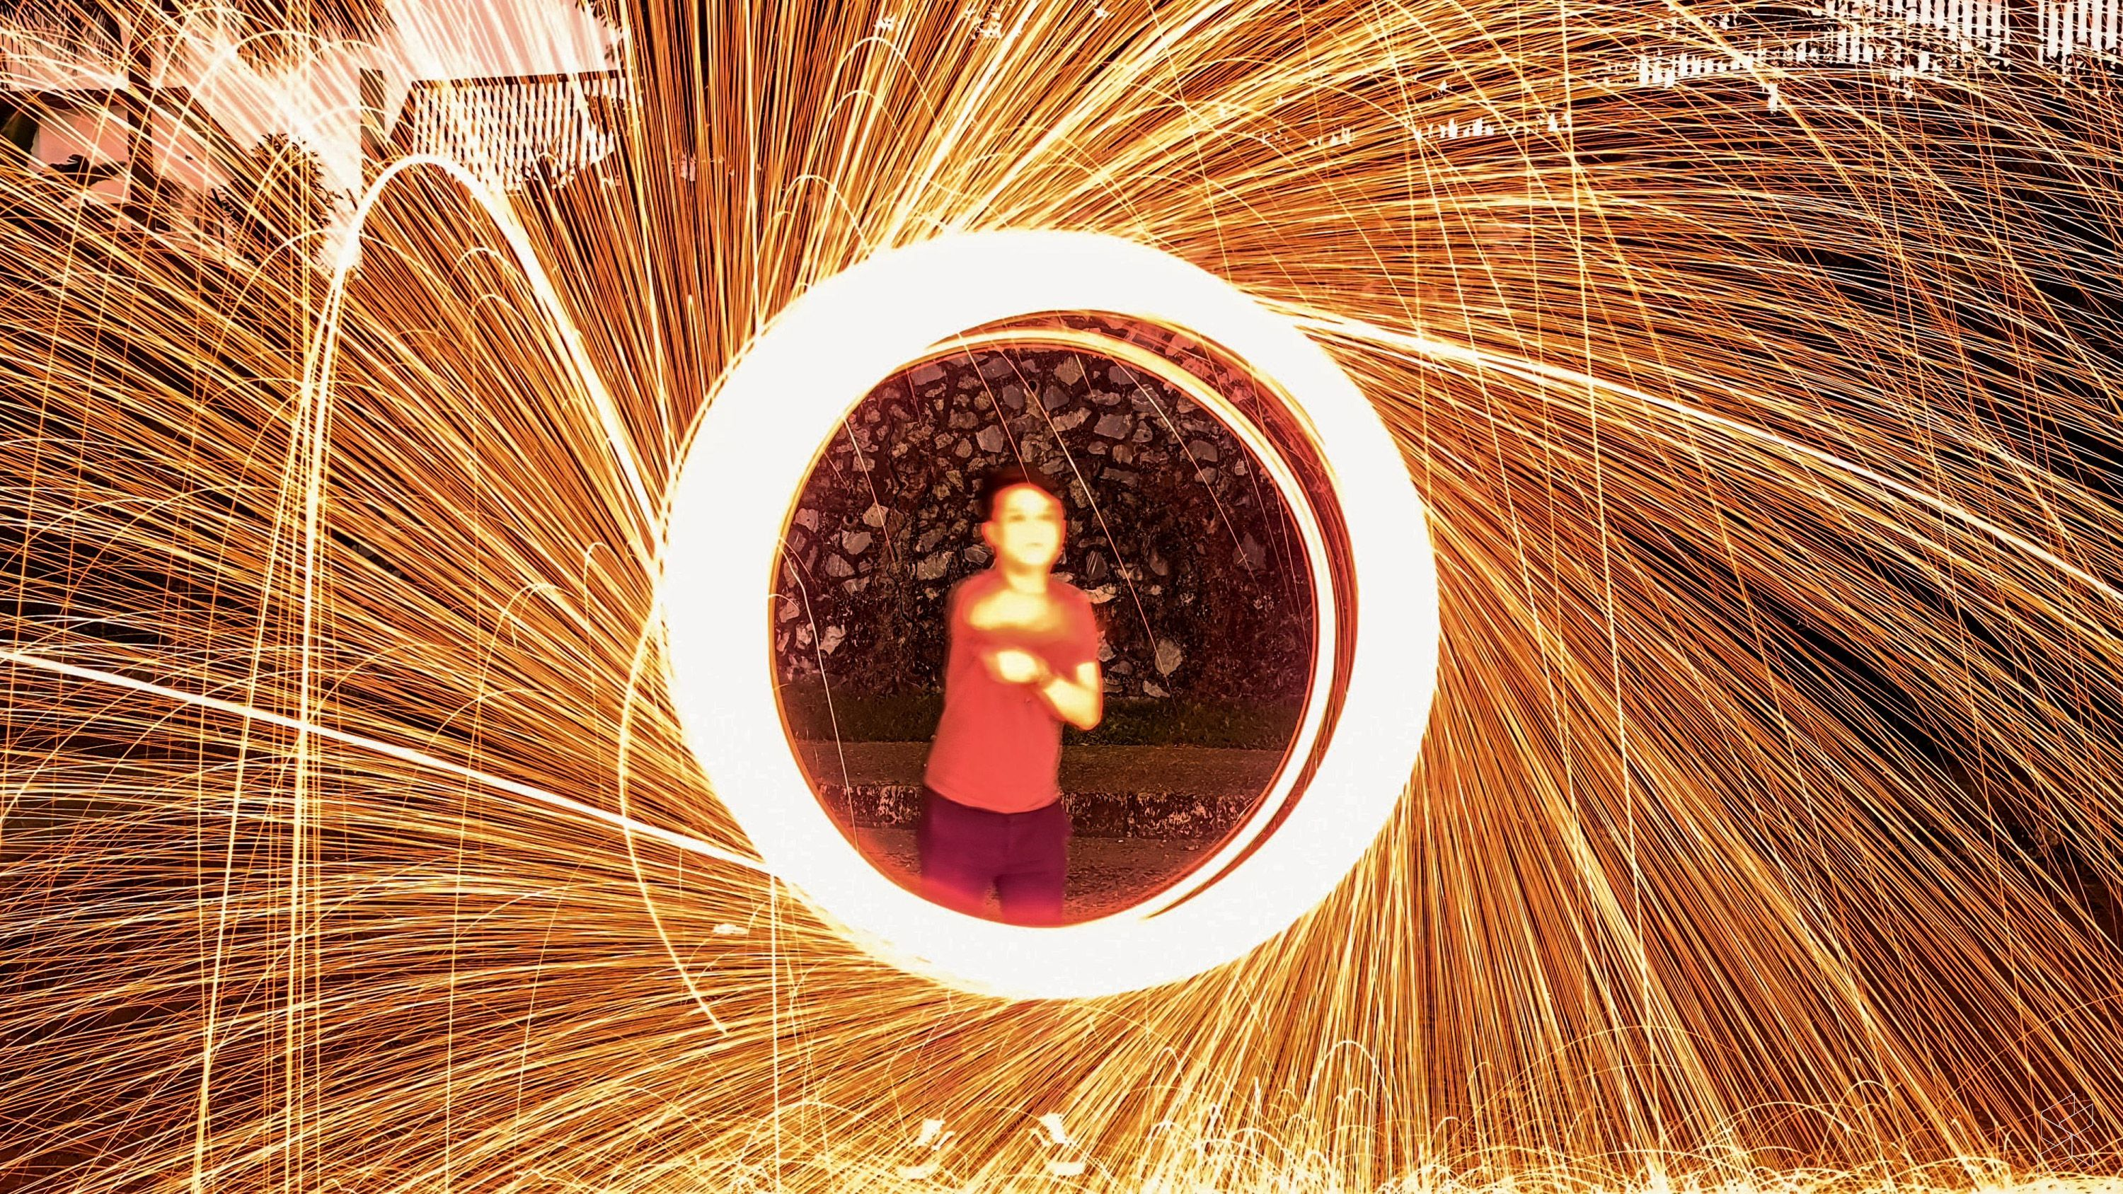
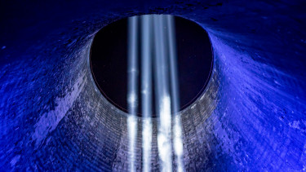
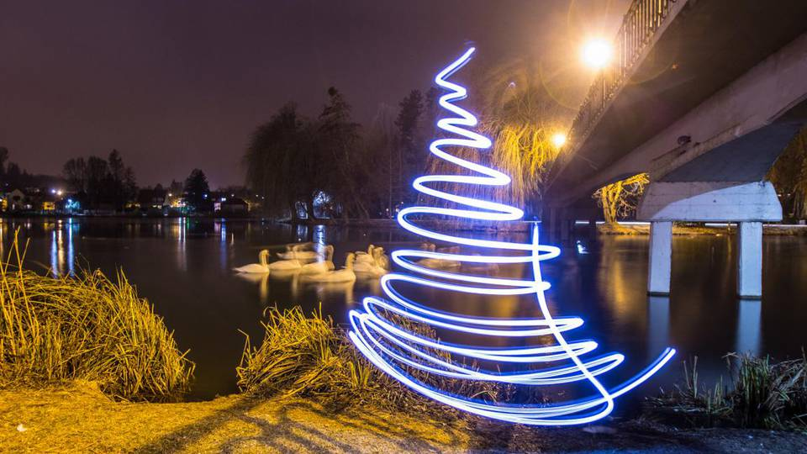

Slide 5
In case of light painting: -we move the light source OR -
we project light through a light-transmitting surface.

Slide 6
the early era of projection before the invention of photography was light painting

Slide 9
light painting is mostly identified with projection onto house walls.

Slide 10
For me personally, in the twilight hours are the most beautiful.

Slide 11
Thomas Wilfred created the Clavilux in 1920, it was the first color projector.

Slide 12
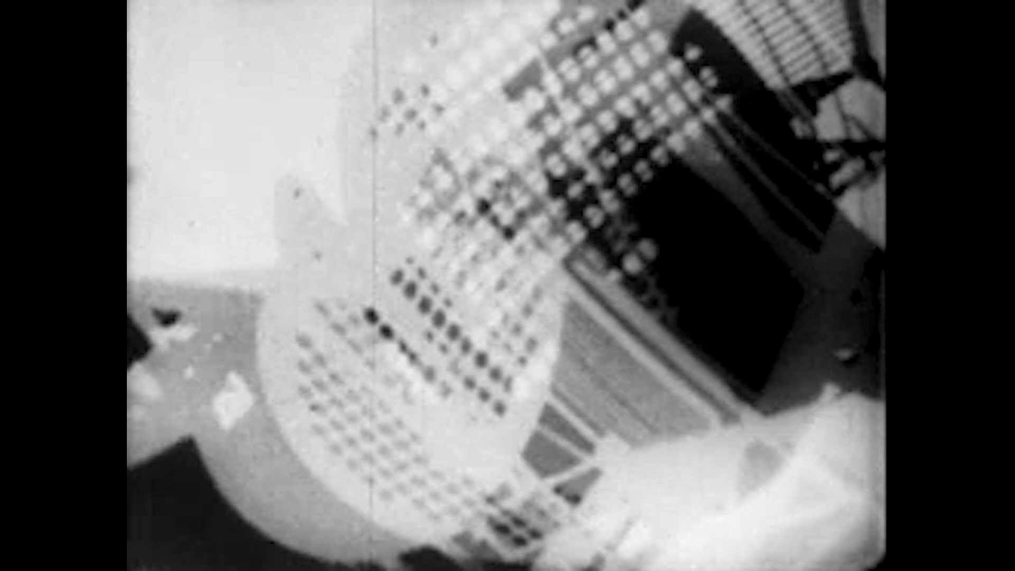
László Moholyi-Nagy was the pioneer of light painting.

Slide 14
..but nature can also be artistic with light.

Slide 15
let’s see some practical examples of light painting:

Slide 17
how to take the best cave photo?...

Slide 18
…with the so-called ”light wallpapering”.

Slide 19
One of the most popular photo subjects is capturing the movement of cars at night with light painting.

Slide 20
can you see light painting in the picture?

Slide 21
...yes, we projected a added light on the face with a mobile phone.

Slide 23
water can also be painted with light

Slide 24
light painting along the outline of objects

Slide 25
thank you for your attention!

